Slide 1
Leading greatly: Leadership as a Christian in any setting
Andy Rowell
Cornerstone Church
http://www.cornerstonecrystal.org/
November 15, 2015
PowerPoint slides at andyrowell.net

Slide 2
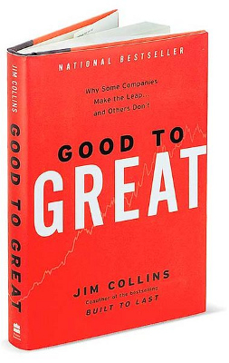
Course description: Leading greatly: Leadership as a Christian in any setting
The 2001 business book Good to Great by Jim Collins is still in the top twenty Business Management & Leadership books sold at Amazon.com. But Jesus too gives instructions for “whoever wants to become great” (Mark 10:43). And the apostle Paul says to “eagerly desire the greater gifts” (1 Cor 12:31). In each, there is an ambition to become great. Drawing on both secular leadership literature like Collins and the Bible, Andy Rowell will teach three interactive, practical sessions on becoming a great leader in any setting.

Slide 3
Schedule
Nov 1. Title: The focus of a great leader: Passion for Mission and for People. Text: Mark 10:35-45. Topics: The textbook definition of leadership. Tyrants and Niceness. Why servant leadership is not enough. Why you matter.
Nov 8. Title: Becoming a great leader: Character, Gifting, and Team. Text: Romans 12:1-16. Topics: Long-term formation in health. Gratitude for gifts and pursuing more. Investing in people. How you can become a great leader.
Nov 15. Title: The approach of a great leader: Innovation, Discipline, and Results. Text: 1 Peter 3:8-18. Topics: Savvy in a wild world. Perseverance. Neither optimism nor pessimism. Navigating through the gauntlet of organizational chaos.

Slide 4
The approach of a great leader: Innovation, Discipline, and Results.
Nov 15. Title: The approach of a great leader: Innovation, Discipline, and Results. Text: 1 Peter 3:8-18. Topics: Savvy in a wild world. Perseverance. Neither optimism nor pessimism. Navigating through the gauntlet of organizational chaos.

Slide 5
Results: Innovation and Discipline
Name a couple of things your organization need to accomplish.
What is the role of creativity, innovation, experimentation in reaching those goals?
Or, on the other hand, do you just need to execute more efficiently on what you already know needs to be done?

Slide 6
Acts 15 The most famous church meeting in the world
Before the church, there is was little sense of moving beyond tribe and nationality.
We don’t talk about bureaucracy because it matters but because the most important things in the world depend on leadership.
Leadership is messy. The issues are subtle. Many people are “good intentions.”
Leadership matters because the world depends on it.
Wise leadership is gracious, provisional, prayerful, and prioritizing.

Slide 7
All things to all people
1 Cor 9:22 "I have become all things to all people so that by all possible means I might save some." I used to think this was taken out of context but have come to see Paul was quite a chameleon--or at least very savvy and tuned in to culture.

Slide 8
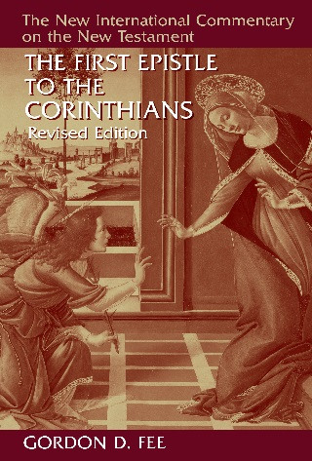
Discipline
“In contrast to the absurd boxer, who would merely flail the air not hit his opponent, Paul ‘boxes’ with real purpose.”
Gordon D. Fee, The First Epistle to the Corinthians, Revised ed., New International Commentary on the New Testament (Grand Rapids, Mich.: W.B. Eerdmans Pub. Co., 2014), 484.

Slide 9
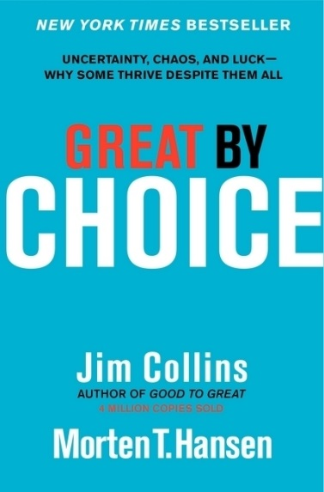
Fanatic discipline
The apostle Paul (beat my body, refusing pay) is paranoia / disciplined and fanatical/unconventional (become like a Jew to the Jews, etc.)
Paul pursues purpose beyond himself (Collins, 31).

Slide 10
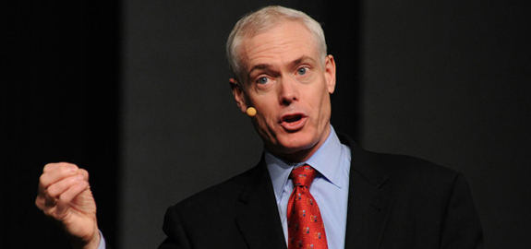
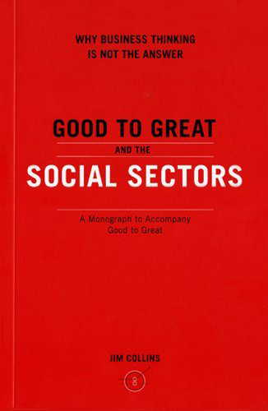
The importance of discipline
“We must reject the idea—well-intentioned, but dead wrong—that the primary path to greatness in the social sectors is to become ‘more like a business.’ Most businesses—like most of anything else in life—fall somewhere between mediocre and good. Few are great . . .
Mediocre companies rarely display the relentless culture of discipline—disciplined people who engage in disciplined thought and who take disciplined action—that we find in great companies. A culture of discipline is not a principle of business; it is a principle of greatness.”
Jim Collins, Good to Great and the Social Sectors: Why Business Thinking Is Not the Answer: A Monograph to Accompany Good to Great (Boulder, Colo.: J. Collins, 2005), 1.
Notes:
Not all business practices are worth emulating, only good ones. Jim Collins is one of the leading business writers. Everything he writes is worth reading.

Slide 11
Paul’s savvy
1 Cor 10
27 If an unbeliever invites you to a meal and you want to go, eat whatever is put before you without raising questions of conscience. 28 But if someone says to you, “This has been offered in sacrifice,” then do not eat it, both for the sake of the one who told you and for the sake of conscience.

Slide 12
What might it mean to eat with outsiders?
But the Pharisees and the teachers of the law muttered, “This man welcomes sinners and eats with them.” Luke 15:2
If an unbeliever invites you to a meal and you want to go, eat whatever is put before you without raising questions of conscience. 1 Cor 14:27
Just then his disciples returned and were surprised to find him talking with a woman. John 4:27

Slide 13
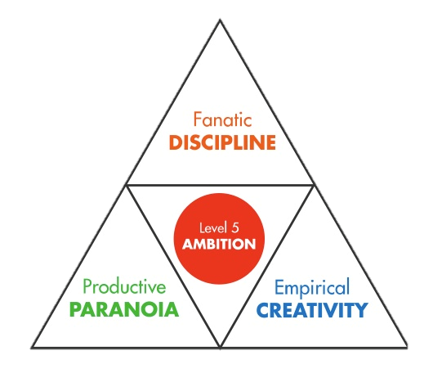
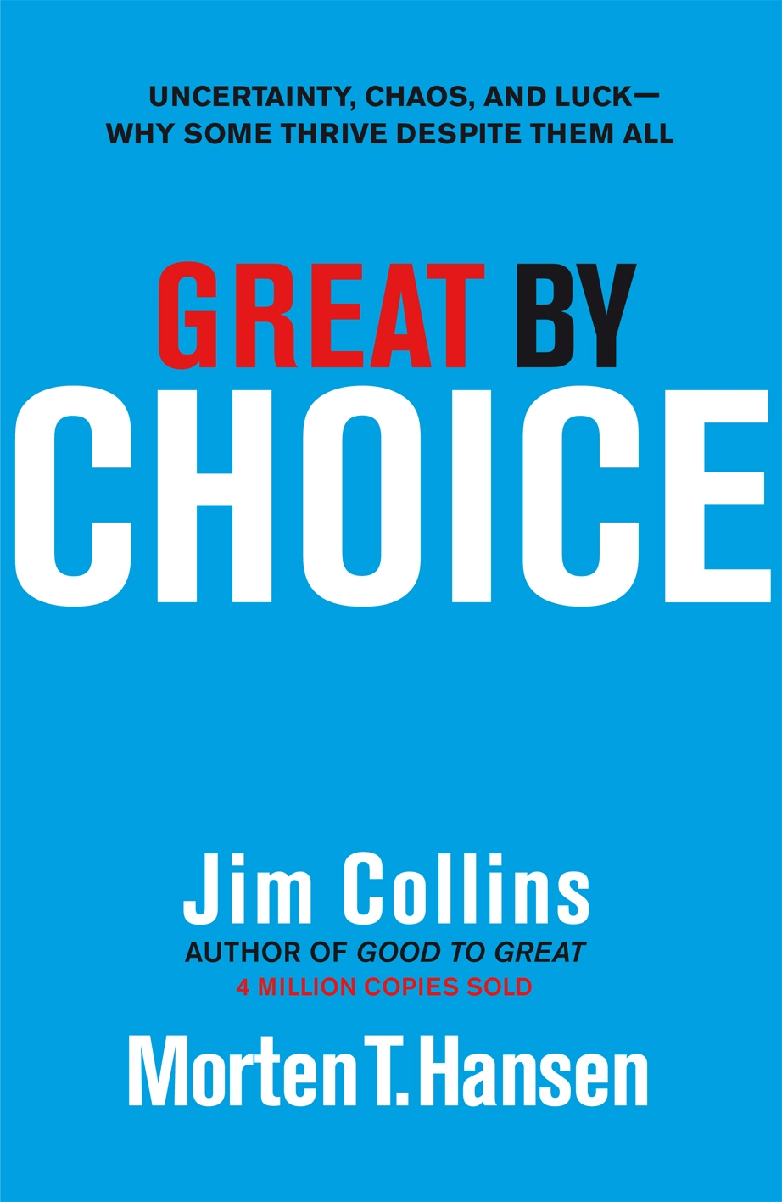
Jim Collins: Fire bullets, then cannonballs
“A bullet is an empirical test aimed at learning what works.”
“they view mistakes as expensive tuition”
“10Xers do not have any particular genius for visionary prediction.”
Jim Collins and Morten T. Hansen, Great by Choice: Uncertainty, Chaos, and Luck--Why Some Thrive Despite Them All (New York, NY: HarperCollins Publishers, 2011), 81, 87, 90.

Slide 14
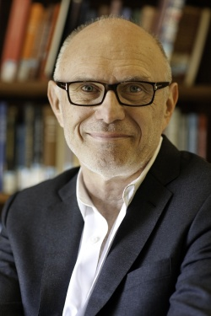
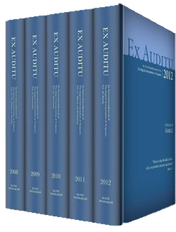
No single approach to culture will be adequate
“there is no single proper way for Christians to relate to a given culture as a whole. Instead, there are numerous ways of accepting, rejecting, subverting or transforming various aspects of a culture which itself is a complex pattern of symbols, beliefs, values, practices and organizations that are partly congruent with one another and partly contradictory.”
Miroslav Volf, "Soft Difference: Theological Reflections on the Relation between Church and Culture in 1 Peter," Ex auditu 10 (1994): 27.

Slide 15
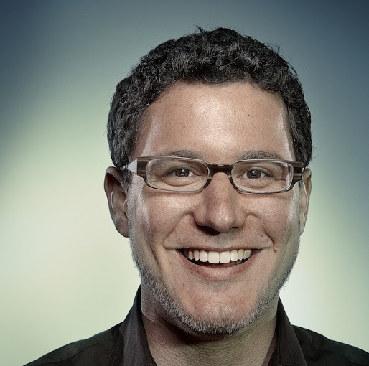
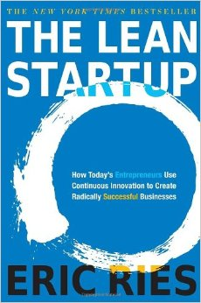
Build, Measure, Learn
“the first step is to enter the Build phase as quickly as possible with a minimum viable product (MVP). The MVP is that version of the product that enables a full turn of the Build-Measure-Learn loop with a minimum amount of effort and the least amount of development time . . . we must be able to measure its impact . . . [then] pivot … or persevere.”
Eric Ries, The Lean Startup: How Today's Entrepreneurs Use Continuous Innovation to Create Radically Successful Businesses (New York: Crown Business, 2011), 75-76.

Slide 16
Myths
“Entrenched myth: Successful leaders in a turbulent world are bold, risk-seeking visionaries.
Contrary finding: The best leaders we studied did not have a visionary ability to predict the future. They observed what worked, figured out why it worked, and built upon proven foundations. They were not more risk taking, more bold, more visionary, and more creative than the comparisons. They were more disciplined, more empirical, and more paranoid.”
Collins, Great by Choice, 9.

Slide 17
Reactions to us will be diverse
“the ‘world’ does not seem a monolithic place in 1 Peter. We encounter evil people who persecute Christians and who will continue to do the same, blaspheming what is most holy to Christians (4:4,12). We come across ignorant and foolish people who will be silenced by Christian good behavior (2:15). We meet people who know what is wrong and what is right and are ready to relate to Christians accordingly (2:14). Finally, we encounter people who see, appreciate, and are finally won over to the Christian faith (2:12; 3:1). Thus, the picture is more complex than just the two extreme and contrary reactions. This testifies to a sensitivity in 1 Peter for the complexity of the social environment.”
Miroslav Volf, "Soft Difference: Theological Reflections on the Relation between Church and Culture in 1 Peter," Ex auditu 10 (1994): 26.

Slide 18
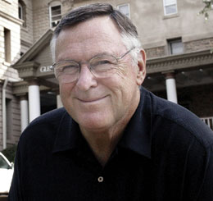
Ready, fire, aim. Aren’t good intentions enough? Robert Lupton says it is worth measuring how are experiments are working.
“In the United States, there’s a growing scandal that we both refuse to see and actively perpetuate. What Americans avoid facing is that while we are very generous in charitable giving, much of that money is either wasted or actually harms the people it is targeted to help. I don’t say this casually or cavalierly. I have spent over four decades working in inner-city Atlanta and beyond, trying to develop models of urban renewal that are effective and truly serve the poor.”
Robert D. Lupton, Toxic Charity: How Churches and Charities Hurt Those They Help (and How to Reverse It) (New York, NY: HarperOne, 2011), 1.

Slide 19
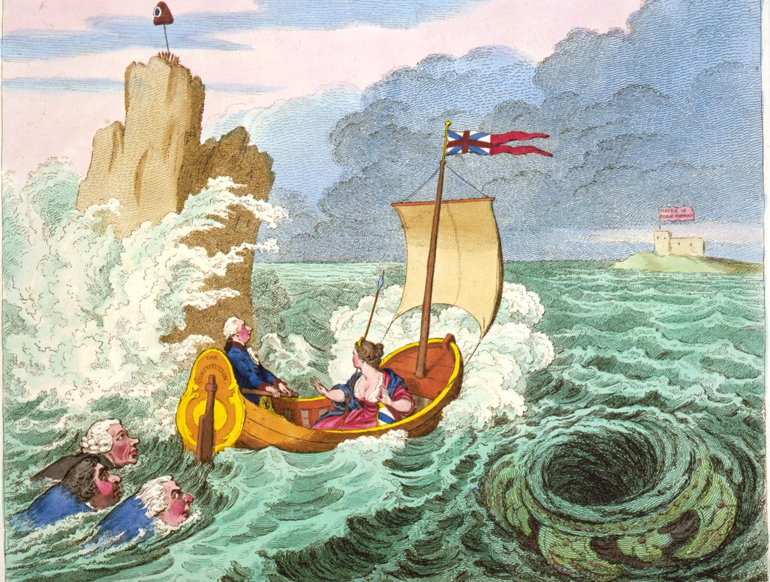
The missiological challenge for the church
Scylla of failing to communicate
Charybdis of unfaithfulness

Slide 20
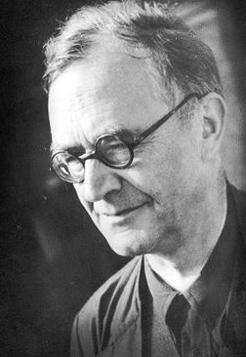
Karl Barth warns of the "secularisation" temptation
"The other form of apostasy is . . . the church which does not take itself seriously enough because it is only half sure of its cause, which takes up this cause only hesitantly and with reservations and compromises, which only in a timid and uncommitted way ventures to give itself to its task."
Karl Barth, The Christian Life: Church Dogmatics IV.4. Lecture Fragments (Grand Rapids, Mich.: Eerdmans Pub. Co., 1981), 137.
It harbors a "secret respect for the fashion of the world . . . secret hankering after its glory . . . secret fear that the church cannot live solely by Jesus Christ and the free grace of God."
Barth, Church Dogmatics, IV/2, 668.

Slide 21
Karl Barth calls withdrawal the "sacralisation" temptation
"By trying to be important and powerful within the world instead of serving, by trying to be great instead of small, by trying to make pretentious claims for itself instead of soberly advocating the claim of God, the church withdraws from the world . . . separates itself for its own pleasure from poor, sinful, erring humanity bleeding from a thousand wounds, trying to impose itself where it owes its witness, and denying and suppressing its witness by witnessing only to itself."
Karl Barth, Church Dogmatics, 4 vols. in 13 parts vols. (Edinburgh, New York: T&T Clark, 1956-1969, 1975, 2009), IV/2, 669-670.

Slide 22
Surprising reversal: 1 Peter 2:11-12 (NIV)
¹¹ Dear friends, I urge you, as foreigners and exiles, to abstain from sinful desires, which wage war against your soul. ¹² Live such good lives among the pagans that, though they accuse you of doing wrong, they may see your good deeds and glorify God on the day he visits us.

Slide 23
Rejection and Admiration
“‘Conduct yourself honorably among the Gentiles, so that, through that for which they malign you as evildoers, they may see your honorable deeds and glorify God when he comes to judge’ (2:11). The very actions which the Gentiles malign as evil deeds, will ultimately be recognized by them as good deeds if Christians do consistently what non-Christians malign.”
Miroslav Volf, "Soft Difference: Theological Reflections on the Relation between Church and Culture in 1 Peter," Ex auditu 10 (1994): 25-26.

Slide 24
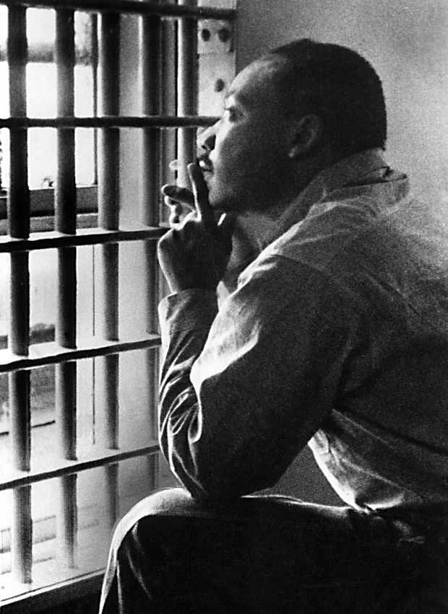
Action
We will have to repent in this generation not merely for the hateful words and actions of the bad people but for the appalling silence of the good people. Human progress never rolls in on wheels of inevitability; it comes through the tireless efforts of men willing to be coworkers with God, and without this hard work, time itself becomes an ally of the forces of social stagnation.
Martin Luther King, Jr. "Letter from a Birmingham Jail." 1963.

Slide 25
Instead we will be curious and courageous
“Christians nevertheless have a mission in the world. They should conduct themselves ‘honorably among the Gentiles.. .so that they may see your honorable deeds and glorify God when he comes to judge’ (2:12; cf. 3:lf). Indeed, the purpose of Christian existence as a whole is to ‘proclaim the mighty acts of him who called you out of darkness into his marvelous light’ (2:9). . . Instead of leading to isolation, this distance is a presupposition of mission . . . To make a difference, one must be different . . . Fear for oneself and one's identity creates hardness . . . A decision for a soft difference, on the other hand, presupposes a fearlessness which 1 Peter repeatedly encourages his readers to assume (3:14; 3:6). People who are secure in themselves—more accurately, who are secure in their God—are able to live the soft difference without fear.”
Miroslav Volf, "Soft Difference: Theological Reflections on the Relation between Church and Culture in 1 Peter," Ex auditu 10 (1994): 24.

Slide 26
Our proper place: The Spirit precedes us
Barth says it is the Holy Spirit who is at work. Let’s put the Spirit’s name first on the placard.
The Holy Spirit and the gathering of the Christian community (IV/1, section 62).
The Holy Spirit and the upbuilding of the Christian community (IV/2, section 67)
The Holy Spirit and the sending of the Christian community (IV/3, section 72).

Slide 27
But we must still try something
“If Christians cannot do what the Spirit does, and they should not pretend that they can, they may and should follow Him in what He does . . . Even the most stringent self-criticism must never be a reason or occasion for prudently doing nothing. Better something …over-bold . . . than nothing at all!”
Karl Barth, Church Dogmatics, IV/3.2, 779-780.

Slide 28
Results - 1 Peter 3:13-18 (NIV)
¹³ Who is going to harm you if you are eager to do good? ¹⁴ But even if you should suffer for what is right, you are blessed. “Do not fear their threats; do not be frightened.” ¹⁵ But in your hearts revere Christ as Lord. Always be prepared to give an answer to everyone who asks you to give the reason for the hope that you have. But do this with gentleness and respect, ¹⁶ keeping a clear conscience, so that those who speak maliciously against your good behavior in Christ may be ashamed of their slander.¹⁷ For it is better, if it is God’s will, to suffer for doing good than for doing evil. ¹⁸ For Christ also suffered once for sins, the righteous for the unrighteous, to bring you to God. He was put to death in the body but made alive in the Spirit.

Slide 29
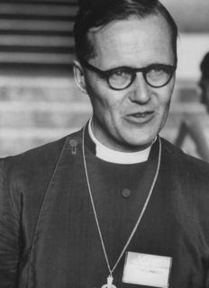
Results
I am neither an optimist nor a pessimist. Jesus Christ is risen from the dead.
Cf. Lesslie Newbigin, Living Hope in a Changing World (London: Alpha International, 2003), 46.

