Slide 1
Leading greatly: Leadership as a Christian in any setting
Andy Rowell
Cornerstone Church
http://www.cornerstonecrystal.org/
November 1, 2015
PowerPoint slides at andyrowell.net

Slide 2
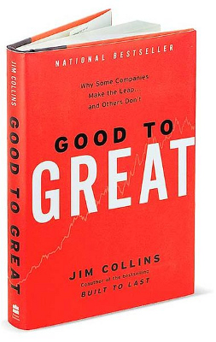
Course description: Leading greatly: Leadership as a Christian in any setting
The 2001 business book Good to Great by Jim Collins is still in the top twenty Business Management & Leadership books sold at Amazon.com. But Jesus too gives instructions for “whoever wants to become great” (Mark 10:43). And the apostle Paul says to “eagerly desire the greater gifts” (1 Cor 12:31). In each, there is an ambition to become great. Drawing on both secular leadership literature like Collins and the Bible, Andy Rowell will teach three interactive, practical sessions on becoming a great leader in any setting.

Slide 3
Schedule
Nov 1. Title: The focus of a great leader: Passion for Mission and for People. Text: Mark 10:35-45. Topics: The textbook definition of leadership. Tyrants and Niceness. Why servant leadership is not enough. Why you matter.
Nov 8. Title: Becoming a great leader: Character, Gifting, and Team. Text: Romans 12:1-16. Topics: Long-term formation in health. Gratitude for gifts and pursuing more. Investing in people. How you can become a great leader.
Nov 15. Title: The approach of a great leader: Innovation, Discipline, and Results. Text: 1 Peter 3:8-18. Topics: Savvy in a wild world. Perseverance. Neither optimism nor pessimism. Navigating through the gauntlet of organizational chaos.

Slide 4
Bio
Andy Rowell is in his third teaching full-time as a professor of ministry leadership at Bethel Seminary. His courses include Introduction to Transformational Leadership, and Organizational Leadership and Church Governance. He did his doctoral work on the theology of the church at Duke University. He regularly attends City Church in southwest Minneapolis, where his wife Amy is Pastor of Community Life. He coaches his kids in soccer, basketball, and baseball.

Slide 5
Introductions
Name
Hobbies/Family
Significant Location(s) / Geography
Leadership / organization you are in or hope to be in
Veteran Cornerstone attendee or newbie?

Slide 6
The focus of a great leader:
Passion for Mission and for People.

Slide 7
Text:
Mark 10:35-45.

Slide 8
Topics:
The textbook definition of leadership. Tyrants and Niceness. Why servant leadership is not enough. Why you matter.

Slide 9
Prayer
Lord God,
help us to know your ways;
teach us your paths.
Lead us in your truth, and teach us,
for you are the God of our salvation;
for you we wait all day long.
Through Christ, our Lord. Amen.
—based on Psalm 25:4-5, NRSV
Calvin Institute of Christian Worship and Faith Alive Christian Resources, The Worship Sourcebook (Grand Rapids, Mich.: Calvin Institute of Christian Worship: Faith Alive: Baker Books, 2004), 140.

Slide 10
A tale of two bosses: Slide 1 of 3
Two Cornerstone Church attenders walk in to a Caribou Coffee.
Alan: So, how’s that famous boss of yours?
Jeff: The good news? He’s passionate, talented, and our organization has grown a ton. The bad news? You don’t want to question him unless you want to lose your job. And he emphasizes performance to such an extent that a lot of our people cut corners in ways that make me cringe. That’s called “innovation” they tell me. I said something about “integrity” and one of his lieutenants told me to quit complaining and whining. How’s your really kind boss?

Slide 11
A tale of two bosses: Slide 2 of 3
Alan: I don’t know if I’m going to sound ungrateful here. My boss is certainly a nice guy. He’s friendly. He chats with people. He’s always saying he has a great staff. In contrast to your boss, it is hard for me to imagine him ever firing anyone ever. The problem I suppose is that the organization has been bleeding financially for a while now. It’s pretty bad. And when I go to our organization’s meetings, it seems to me we are pretty much doing the same old, same old things. At almost every meeting, it dawns on me again that we are in trouble—that there is no way we are pulling out of this dive. Our discussions are not even close to being as urgent and organized as they would need to be for us to deal with what we’re facing.

Slide 12
A tale of two bosses: Slide 3 of 3
Jeff: Ouch. It makes me a little grateful for my hard-driving boss—though I wouldn’t mind not worrying about losing my job for a little while.
Alan: Yeah. My job is pretty stable but there is also something a little soul-killing about seeing the organization just drift off like this. Sometimes clients and customers ask me about poor quality they notice. I shrug and say “Yeah, I know it isn’t great. We’re working on that.” But then it occurs to me that they’re just seeing the tip of the iceberg. There are like a million of those things that need to change.

Slide 13
React to this scenario about the two types of leaders
First respond emotionally. Who do you resonate with? Which person expressed things you tend to say about your boss or organization?
Which kind of leader would you rather have: The task-oriented harsh leader who gets stuff done or the people-oriented leader who cares for people but the organization drifts?
Have you more often in life been wounded by a harsh leader or been frustrated under poor leadership?

Slide 14
Reflect on this scenario about the two types of leaders
Which kind of leader do you tend to be: Task-oriented or people-oriented?
What is the value of both kinds? As Christians, what would be the value of each?

Slide 15
Case study
“Leader” who does very little but is nice. Instead of case study, Dilbert?
Ned Yost – Royals manager
Ben Carson: He’s a nice man
“Leader” who is a tyrant. Instead of case study, Dilbert?
Amazon
Donald Trump: You’re fired!
Steve Jobs
Mark Driscoll
Lance Armstrong
Three Cups of Tea

Slide 16
Mission and People
Task and Relationship

Slide 17
The Behavioral approach: task or relationship Behavior
The Ohio State Studies: Two general types of leader behaviors: initiating structure and consideration.
The University of Michigan Studies: Two types of leadership behaviors: production orientation and employee orientation
Blake and Mouton’s Managerial (Leadership) Grid: Two factors: concern for production and concern for people.
Peter G. Northouse, Leadership: Theory and Practice, 7th ed. (Thousand Oaks, CA: SAGE, 2016), ch. 4.

Slide 18
Utilitarian or Deontological: Task OR Relationship
Utilitarian ethics: the person should do the greatest good for the greatest number of people. (The ends justify the means. There may be very little compassion here for individuals who get in the way). The leader focused on the “task” or efficiency is operating with this mentality. Their organization will be successful but they may be hated.
Deontological ethics: The person should do the right thing, regardless of the consequences. (There may be terrible results of someone who claims that they were merely trying to do good. There is very little thinking here; one makes decisions based on a few slogans or beliefs). The leader who is very relational and conscientious about the doing the right thing is operating with this mentality. Their organization likely will be largely ineffective but they will be liked. (Virtue-ethics functions just like deontological ethics when the virtues are considered in isolation from a tradition like Christianity).
Peter G. Northouse, Leadership: Theory and Practice, 7th ed. (Thousand Oaks, CA: SAGE, 2016), ch. 13.

Slide 19
Virtue Ethics reconsidered
Rightly understood, we need not choose utilitarian or deontological approaches. We need not think only of the ends nor only of the means but rather both. Virtue ethics, rightly understood, involves immersion in our tradition of practices, values, virtues, habits, stories, community, mentors, and peers that train us into how to approach such situations.
To be fine Christian leaders then does not mean we will do anything to make disciples of Jesus (regardless of whether we are being cruel or manipulative) though this would theoretically be allowed in a utilitarian approach. Nor, do we ignore God’s plan to show the world who He is through his people, and just “love everybody” (a deontological approach).
No, it is a combination of task and relationship (right ends and right means). We learn to be those kind of leaders by seeping in the wisdom of church history, systematic theology, right living, the Scriptures, and learning from mentors and peers.

Slide 20
Definition of leadership

Slide 21
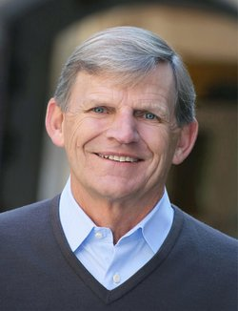
Textbook definition of leadership
“Leadership is a process whereby an individual influences a group of individuals to achieve a common goal.”
Peter G. Northouse, Leadership: Theory and Practice, 7th ed. (Thousand Oaks, CA: SAGE, 2016), 6.
There are some who would argue that this definition gives too much emphasis to the "goal." They would say that as long as the leader loves their followers, they have been a "good leader" regardless of whether any goal is reached.

Slide 22
Similar definitions of leadership
Leadership is the art of getting people to want to do what must be done. - Jim Collins paraphrasing Dwight Eisenhower.
We define leadership as moving people from HERE to THERE. - Bill Hybels

Slide 23
Dwight Eisenhower
"Now I think, speaking roughly, by leadership we mean the art of getting someone else to do something that you want done because he wants to do it, not because your position of power can compel him to do it, or your position of authority. A commander of a regiment is not necessarily a leader. He has all of the appurtenances of power given by a set of Army regulations by which he can compel unified action. He can say to a body such as this, "Rise," and "Sit down." You do it exactly. But that is not leadership."
Remarks at the Annual Conference of the Society for Personnel Administration, 5/12/54

Slide 24
Mission
Task matters

Slide 25
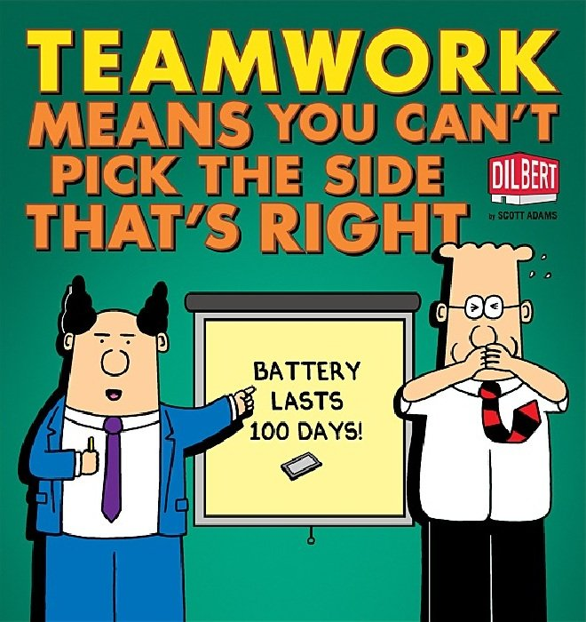
Dilbert (on the right, the engineer) is here stifling what he knows to be right—what he is supposed to be doing—the task for the sake of his relationships with his pointy-haired boss on the left. The boss’s motto here is “We’re a team!”

Slide 26
Why task(?) is really the same question as Why leadership(?)
What is worth doing in this world?
Or, should we just ignore ends (goals / purpose / task) altogether and just withdraw and seek purity by doing no harm?

Slide 27
Tasks matter
How is leadership related to achieving a common goal? Or, how is the leader’s role connected to the organization’s goal? How would you describe what Christians are to do in this world? Why do we need leaders for that; would not individuals just achieve common goals without coordination?
Optional questions: What is the goal or purpose of the group(s) you are part of? Might you further that goal better? What is the role of the follower in contrast to the leader? How might your group better align itself with its purpose / task / goal?

Slide 28
There are things worth doing.

Slide 29
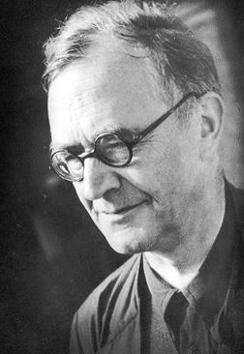
Why was the confessing church needed?
“I’d say the answer lies simply in naming one name: Adolf Hitler. It was about an appeal: ‘Germany, wake up from this dream.’”
https://www.youtube.com/watch?v=drq9hz5tYDI
Notes:
Barth was Bonhoeffer's mentor and twenty years older than him. Barth was exiled from Germany in 1934 back to his home country of Switzerland. Here are 12 pages from the greatest theologian of the 20th century—describing two ways the church can get it wrong. "Barth" is pronounced like the Bart in Bart Simpson. This section was written in Switzerland in the German language in 1959 and translated here. You are reading 812-824 (look at the page numbers on the sides of the page which refer to the original English translation—not the bottom page numbers of this Study Edition). Like Bonhoeffer, when Barth says "Community" (the word again is Gemeinde in German) he is talking about the "church" and he has in mind primarily local groups of Christians. Needless to say Barth is difficult reading—probably the hardest you will read all semester—but he is good and substantive and I am hoping you will develop a taste for him. I hope you will be inspired by the idea that leadership by Christians is needed to help groups of Christians (i.e. the church) navigate the twin temptations Barth names here: being too much like the world and failing to engage the world at all. Barth says the church's task is to "witness" to Jesus Christ (IV/3.2, 797). "Be my witnesses" (Acts 1:8). [If you have an old 14 volume copy of the Church Dogmatics lying around, this is from volume 12 labeled "IV.3.2". We are reading from section §72—which is fantastic and begins on page 681 and the subsection on "The Task of the Community" which we are reading from starts on page 795].

Slide 30
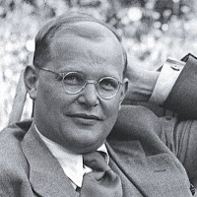
Dietrich Bonhoeffer on the task of Christians
“All this they are to do in the midst of this world and without reservation, in order to bear witness to the fact that the world is lost and the new creation has come about in the church-community . . . Christians are to remain in the world in order to engage the world in a frontal assault.”
Dietrich Bonhoeffer, Discipleship, trans., Barbara G. Green and Reinhard Krauss, Dietrich Bonhoeffer Works, vol. 4 (Minneapolis: Fortress, 2001), 244.
Notes:
This is chapter eleven entitled “The Visible Church-Community” from Bonhoeffer’s Discipleship—written in German in 1935-1936 and published in 1937 at the height of Hitler’s power and translated into English here. Bonhoeffer was executed by order of Hitler in 1945. You are welcome to read the chapter in your own version of Cost of Discipleship: it may be chapter 30 and entitled “The Visible Community.” Bonhoeffer is concious of evil leadership and the importance of Christians to boldly follow Jesus—which involves leadership. When Bonhoeffer says “community” or “church-community” he is talking about a local church or group of Christians (Gemeinde).

Slide 31
God has given a task – a commission
Therefore go and make disciples of all nations, baptizing them in the name of the Father and of the Son and of the Holy Spirit, and teaching them to obey everything I have commanded you.
Matthew 28:18-20 (NIV)

Slide 32
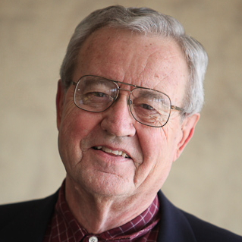
Dallas Willard on effort
“Grace is not opposed to effort, but it is opposed to earning.”
Dallas Willard, The Great Omission: Rediscovering Jesus' Essential Teachings on Discipleship (San Francisco: HarperSanFrancisco, 2006), 61, 133, 166.
Sometimes Christians think that leadership intrudes upon God’s sphere of influence. Results, effectiveness—that’s God’s department.
Some might bristle at the idea that we have a “task” but it is not “Pelagian” or “Armenian” to try to obey the Great Commission.

Slide 33
God’s plan is to use Christians
“Before the creation of the world,” (Eph 1:4), God’s plan was to use a people to point to him. “His intent was that now, through the church, the manifold wisdom of God should be made known!” (Eph 3:10).
If you are having difficulty remembering that the church is not a building, substitute the words “Christians” or “followers of Jesus” as this is closer. This should also help you see that virtually the same things that are said biblically about the church can be said about other Christian organizations and even groups of Christian individuals. “His intent was that now, through we Christians, the manifold wisdom of God should be made known!”

Slide 34
What is the task of Christians?
“To use the simplest and biblical formulation: ‘You will be my witnesses’ (Acts 1:8).”
Karl Barth, Church Dogmatics, 4 vols. in 13 parts vols. (New York: T&T Clark, 1956-1969, 1975, 2009), IV/3.2, 797.
Notes:
Barth was Bonhoeffer's mentor and twenty years older than him. Barth was exiled from Germany in 1934 back to his home country of Switzerland. Here are 12 pages from the greatest theologian of the 20th century—describing two ways the church can get it wrong. "Barth" is pronounced like the Bart in Bart Simpson. This section was written in Switzerland in the German language in 1959 and translated here. You are reading 812-824 (look at the page numbers on the sides of the page which refer to the original English translation—not the bottom page numbers of this Study Edition). Like Bonhoeffer, when Barth says "Community" (the word again is Gemeinde in German) he is talking about the "church" and he has in mind primarily local groups of Christians. Needless to say Barth is difficult reading—probably the hardest you will read all semester—but he is good and substantive and I am hoping you will develop a taste for him. I hope you will be inspired by the idea that leadership by Christians is needed to help groups of Christians (i.e. the church) navigate the twin temptations Barth names here: being too much like the world and failing to engage the world at all. Barth says the church's task is to "witness" to Jesus Christ (IV/3.2, 797). "Be my witnesses" (Acts 1:8). [If you have an old 14 volume copy of the Church Dogmatics lying around, this is from volume 12 labeled "IV.3.2". We are reading from section §72—which is fantastic and begins on page 681 and the subsection on "The Task of the Community" which we are reading from starts on page 795].

Slide 35
Pointing to Jesus Christ can take many forms

Slide 36
People
Relationship matters

Slide 37
People matter
What means of leadership should we use as Christians? Or, what’s wrong with using any means necessary to get something good done. Do the ends justify the means? If you are trying to help the poor or communicate the good news, can you use questionable means to do so (like lying, cheating, murder, torture, sexual immorality, bribery?)

Slide 38
People matter
Consider the dynamics of task and relationship in leadership. In teleological ethics, one seeks good ends. In deontological ethics, one seeks good means.
What means of leadership should we use as Christians? Or, what’s wrong with using any means necessary to get something good done. Do the ends justify the means? If you are trying to help the poor or communicate the good news, can you use questionable means to do so (like lying, cheating, murder, torture, sexual immorality, bribery?) Or, to go to the other extreme, should we ignore the ends (goals / purpose / task) altogether and just withdraw and seek purity by doing no harm?
Optional question: Are you or your organization more tempted to use shady means to get things done or are you more tempted to withdraw and just be pure?

Slide 39
Task-oriented can go very wrong.
“Hitler, Stalin, and Pol Pot come immediately to mind: all power-made and evil but nonetheless highly effective as leaders.”
Barbara Kellerman, "Leadership Warts and All. (Cover Story)," Harvard Business Review 82, no. 1 (2004), 41.

Slide 40
What are the dangers of the task emphasized exclusively?
“The danger is that narcissism can turn unproductive when, lacking restraining anchors and self-knowledge, narcissists become unrealistic dreamers.”
Michael Maccoby, “Narcissistic Leaders: The Incredible Pros, the Inevitable Cons,” Harvard Business Review 82, no. 1 (2004): 94.
“Those who love their dream of a Christian community more than the Christian community itself become destroyers of that Christian community even though their personal intentions may be ever so honest, earnest and sacrificial. God hates this wishful dreaming because it makes the dreamer proud and pretentious. Those who dream of this idealized community demand that it be fulfilled by God, by others, and by themselves.”
Dietrich Bonhoeffer, Life Together; Prayerbook of the Bible, trans., Daniel W. Bloesch and James H. Burtness, Dietrich Bonhoeffer Works, vol. 5 (Minneapolis: Augsburg Fortress, 1996), 36.

Slide 41
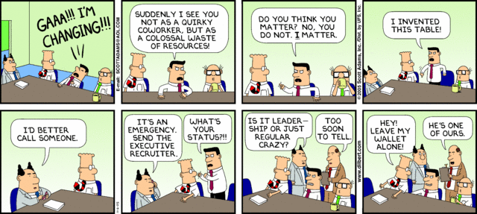
“Leadership” or possessed
http://dilbert.com/strips/comic/2005-11-06/

Slide 42
Mark 10:42-45
42 Jesus called them together and said, "You know that those who are regarded as rulers of the Gentiles lord it over them, and their high officials exercise authority over them. 43 Not so with you. Instead, whoever wants to become great among you must be your servant, 44 and whoever wants to be first must be slave of all. 45 For even the Son of Man did not come to be served, but to serve, and to give his life as a ransom for many."

Slide 43
The servant leadership approach
The idea is that servant behaviors (despite this perhaps being counterintuitive) lead to leadership effectiveness.
Empowerment
Humility
Standing back
Authenticity
Forgiveness
Courage
Accountability
Stewardship
Dirk van Dierendonck, "Servant Leadership: A Review and Synthesis," Journal of Management 37, no. 4 (2011): 1228-1261. in Peter G. Northouse, Leadership: Theory and Practice, 7th ed. (Thousand Oaks, CA: SAGE, 2016), 230.

Slide 44
Comments on Mark 10:42-45
Jesus' way ain't relaxing in comfort with the insiders. Nor is it enjoying stomping on people.
It is focused on outsiders. It is about teleological service. It is not just service to serve but rather is for FREEEDOMMMMMM ("ransom"). But the method matters. Jesus is not using spears.
So we learn from the rulers but we may also need to "rule" differently.

Slide 45
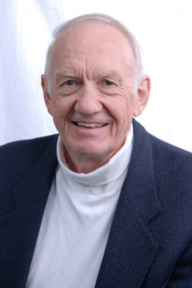
Gordon Fee
“Thus leadership in the New Testament people of God is never seen as outside or above the people themselves, but simply as part of the whole, essential to its well-being, but governed by the same set of ‘rules.’”
Gordon D. Fee, "Laos and Leadership under the New Covenant," in Listening to the Spirit in the Text (Grand Rapids, Mich.: W.B. Eerdmans, 2000), 132.

Slide 46
Dietrich Bonhoeffer on relationships
“Where the world despises other members of the Christian family, Christians will love and serve them . . . It is absolutely paramount that no wrongdoing take place within the Christian community . . . The community of Christ has a ‘form’ that is different from that of the world. The community is called to be increasingly transformed into this form. It is, in fact, the form of Christ himself. He came into the world and in infinite mercy bore us and accepted us.”
Dietrich Bonhoeffer, Discipleship, trans., Barbara G. Green and Reinhard Krauss, Dietrich Bonhoeffer Works, vol. 4 (Minneapolis: Fortress, 2001), 237, 241, 247.

Slide 47
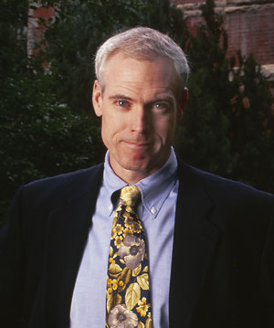
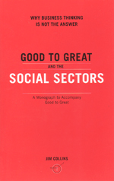
Businesses are not necessarily more disciplined than churches.
“We must reject the idea—well-intentioned, but dead wrong—that the primary path to greatness in the social sectors is to become ‘more like a business.’ Most businesses—like most of anything else in life—fall somewhere between mediocre and good. Few are great . . .
Mediocre companies rarely display the relentless culture of discipline—disciplined people who engage in disciplined thought and who take disciplined action—that we find in great companies. A culture of discipline is not a principle of business; it is a principle of greatness.”
Jim Collins, Good to Great and the Social Sectors: Why Business Thinking Is Not the Answer: A Monograph to Accompany Good to Great (Boulder, Colo.: J. Collins, 2005), 1.
Notes:
Not all business practices are worth emulating, only good ones. Jim Collins is one of the leading business writers. Everything he writes is worth reading.

Slide 48
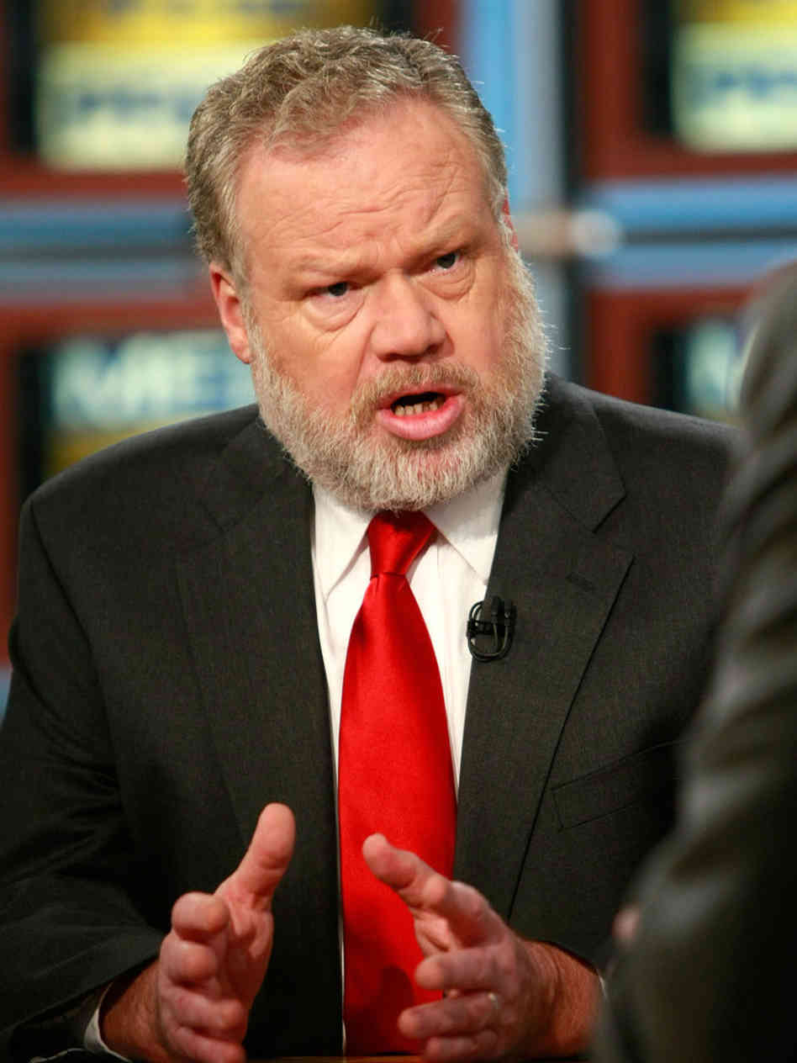
“Niceness” is not just a problem in the church
During World War II, General George “Marshall saw relief as a natural part of generalship. Firing, like hiring, was simply one of the basic tasks of senior managers . . . The Army's shift away from swift dismissal in our recent wars . . . promises a way to better understand why our recent wars in Vietnam, Afghanistan, and Iraq have been so long and frustrating.”
Thomas E. Ricks, The Generals: American Military Command from World War Ii to Today (New York: Penguin Press, 2012).

Slide 49
Passion for Mission and for People

Slide 50
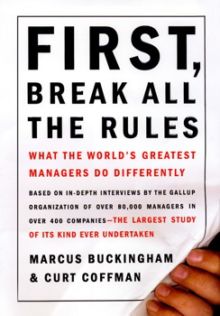
Your influence matters
“Employees rated the questions differently depending on which business unit they worked for rather than which company. This meant that, for the most part, these twelve opinions were being formed by the employee’s immediate manager rather than by the policies or procedures of the overall company. We had discovered that the manager—not pay, benefits, perks, or a charismatic corporate leader—was the critical player in building a strong workplace . . . People leave managers, not companies.”
Marcus Buckingham and Curt Coffman, First, Break All the Rules: What the World's Greatest Managers Do Differently (New York, NY.: Simon & Schuster, 1999), 32-33.

Slide 51
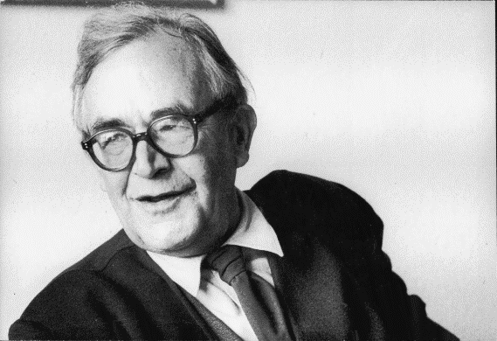
Sometimes Christians don’t believe they can make a difference. Maybe they can’t but . . .
Barth says it is the Holy Spirit who is at work. Let’s put the Spirit’s name first on the placard.
The Holy Spirit and the gathering of the Christian community (IV/1, section 62).
The Holy Spirit and the upbuilding of the Christian community (IV/2, section 67)
The Holy Spirit and the sending of the Christian community (IV/3, section 72).
“If Christians cannot do what the Spirit does, and they should not pretend that they can, they may and should follow Him in what He does . . . Even the most stringent self-criticism must never be a reason or occasion for prudently doing nothing. Better something …over-bold . . . than nothing at all!” (Karl Barth, Church Dogmatics, IV/3.2, 779-780).

Slide 52
John M. Perkins
“Once you get involved, you begin to feel it.”
“I illustrate with crossing the Jordan. The water didn’t part until they waded out into the water.”
http://vimeo.com/19282223

Slide 53
Session 2

Slide 54
Becoming a great leader: Character, Gifting, and Team.
Nov 8. Title: Becoming a great leader: Character, Gifting, and Team. Text: Romans 12:1-16. Topics: Long-term formation in health. Gratitude for gifts and pursuing more. Investing in people. How you can become a great leader.

Slide 55
Relationships
Evaluating and developing the character of the leader

Slide 56
1 Samuel 25
A story of three leaders and their different traits

Slide 57
1 Sam 25:1-11 (NIV)
1 Now Samuel died, and all Israel assembled and mourned for him; and they buried him at his home in Ramah. Then David moved down into the Desert of Paran.[a]
2 A certain man in Maon, who had property there at Carmel, was very wealthy. He had a thousand goats and three thousand sheep, which he was shearing in Carmel. 3 His name was Nabal and his wife’s name was Abigail. She was an intelligent and beautiful woman, but her husband was surly and mean in his dealings—he was a Calebite.
4 While David was in the wilderness, he heard that Nabal was shearing sheep. 5 So he sent ten young men and said to them, “Go up to Nabal at Carmel and greet him in my name. 6 Say to him: ‘Long life to you! Good health to you and your household! And good health to all that is yours!
7 “‘Now I hear that it is sheep-shearing time. When your shepherds were with us, we did not mistreat them, and the whole time they were at Carmel nothing of theirs was missing. 8 Ask your own servants and they will tell you. Therefore be favorable toward my men, since we come at a festive time. Please give your servants and your son David whatever you can find for them.’”
9 When David’s men arrived, they gave Nabal this message in David’s name. Then they waited.
10 Nabal answered David’s servants, “Who is this David? Who is this son of Jesse? Many servants are breaking away from their masters these days. 11 Why should I take my bread and water, and the meat I have slaughtered for my shearers, and give it to men coming from who knows where?”

Slide 58
1 Sam 25:12-22
12 David’s men turned around and went back. When they arrived, they reported every word. 13 David said to his men, “Each of you strap on your sword!” So they did, and David strapped his on as well. About four hundred men went up with David, while two hundred stayed with the supplies.
14 One of the servants told Abigail, Nabal’s wife, “David sent messengers from the wilderness to give our master his greetings, but he hurled insults at them. 15 Yet these men were very good to us. They did not mistreat us, and the whole time we were out in the fields near them nothing was missing. 16 Night and day they were a wall around us the whole time we were herding our sheep near them. 17 Now think it over and see what you can do, because disaster is hanging over our master and his whole household. He is such a wicked man that no one can talk to him.”
18 Abigail acted quickly. She took two hundred loaves of bread, two skins of wine, five dressed sheep, five seahs[b] of roasted grain, a hundred cakes of raisins and two hundred cakes of pressed figs, and loaded them on donkeys. 19 Then she told her servants, “Go on ahead; I’ll follow you.” But she did not tell her husband Nabal.
20 As she came riding her donkey into a mountain ravine, there were David and his men descending toward her, and she met them. 21 David had just said, “It’s been useless—all my watching over this fellow’s property in the wilderness so that nothing of his was missing. He has paid me back evil for good. 22 May God deal with David,[c] be it ever so severely, if by morning I leave alive one male of all who belong to him!”

Slide 59
1 Sam 25:23-35
23 When Abigail saw David, she quickly got off her donkey and bowed down before David with her face to the ground. 24 She fell at his feet and said: “Pardon your servant, my lord, and let me speak to you; hear what your servant has to say. 25 Please pay no attention, my lord, to that wicked man Nabal. He is just like his name—his name means Fool, and folly goes with him. And as for me, your servant, I did not see the men my lord sent. 26 And now, my lord, as surely as the Lord your God lives and as you live, since the Lord has kept you from bloodshed and from avenging yourself with your own hands, may your enemies and all who are intent on harming my lord be like Nabal. 27 And let this gift, which your servant has brought to my lord, be given to the men who follow you.
28 “Please forgive your servant’s presumption. The Lord your God will certainly make a lasting dynasty for my lord, because you fight the Lord’s battles, and no wrongdoing will be found in you as long as you live. 29 Even though someone is pursuing you to take your life, the life of my lord will be bound securely in the bundle of the living by the Lord your God, but the lives of your enemies he will hurl away as from the pocket of a sling. 30 When the Lord has fulfilled for my lord every good thing he promised concerning him and has appointed him ruler over Israel, 31 my lord will not have on his conscience the staggering burden of needless bloodshed or of having avenged himself. And when the Lord your God has brought my lord success, remember your servant.”
32 David said to Abigail, “Praise be to the Lord, the God of Israel, who has sent you today to meet me. 33 May you be blessed for your good judgment and for keeping me from bloodshed this day and from avenging myself with my own hands. 34 Otherwise, as surely as the Lord, the God of Israel, lives, who has kept me from harming you, if you had not come quickly to meet me, not one male belonging to Nabal would have been left alive by daybreak.”
35 Then David accepted from her hand what she had brought him and said, “Go home in peace. I have heard your words and granted your request.”

Slide 60
1 Sam 25:36-44
36 When Abigail went to Nabal, he was in the house holding a banquet like that of a king. He was in high spirits and very drunk. So she told him nothing at all until daybreak. 37 Then in the morning, when Nabal was sober, his wife told him all these things, and his heart failed him and he became like a stone. 38 About ten days later, the Lord struck Nabal and he died.
39 When David heard that Nabal was dead, he said, “Praise be to the Lord, who has upheld my cause against Nabal for treating me with contempt. He has kept his servant from doing wrong and has brought Nabal’s wrongdoing down on his own head.”
Then David sent word to Abigail, asking her to become his wife. 40 His servants went to Carmel and said to Abigail, “David has sent us to you to take you to become his wife.”
41 She bowed down with her face to the ground and said, “I am your servant and am ready to serve you and wash the feet of my lord’s servants.” 42 Abigail quickly got on a donkey and, attended by her five female servants, went with David’s messengers and became his wife. 43 David had also married Ahinoam of Jezreel, and they both were his wives. 44 But Saul had given his daughter Michal, David’s wife, to Paltiel[d] son of Laish, who was from Gallim.

Slide 61
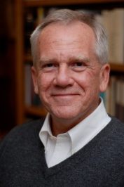
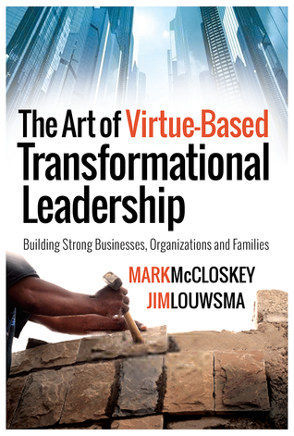
Relationships: McCloskey
Chapter 3.
McCloskey and Louwsma, The Art of Virtue-Based Transformational Leadership: Building Strong Businesses, Organizations and Families, 51-72.

Slide 62
What are the traits of:
David is . . .
Nabal is . . .
Abigail is . . .

Slide 63
The Trait Approach
Major Leadership Traits:
Intelligence
Self-confidence
Determination
Integrity
Sociability
Peter G. Northouse, Leadership: Theory and Practice, 7th ed. (Thousand Oaks, CA: SAGE, 2016), ch. 2.

Slide 64
To get a group to achieve a goal, you need
People skills
Determination

Slide 65
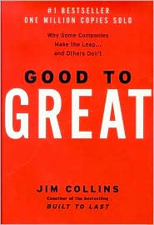
Level 5: Executive
Builds enduring greatness through a paradoxical combination of personal humility plus professional will.
Level 4: Effective Leader
Catalyzes commitment to and vigorous pursuit of a clear and compelling vision; stimulates the group to high performance standards.
Level 3: Competent Manager
Organizes people and resources toward the effective and efficient pursuit of predetermined objectives.
Level 2: Contributing Team Member
Contributes to the achievement of group objectives; works effectively with others in a group setting.
Level 1: Highly Capable Individual
Makes productive contributions through talent, knowledge, skills, and good work habits.
Jim Collins, "Level 5 Leadership: The Triumph of Humility and Fierce Resolve," Harvard Business Review 79, no. 1 (2001): 140.

Slide 66
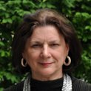
“Resilient people . . . possess three characteristics: (1) a staunch acceptance of reality [a cool, almost pessimistic, sense of reality (48)]; (2) a deep belief, often buttressed by strongly held values, that life is meaningful [the ability . . . to make meaning of terrible times (50))]; and (3) an uncanny ability to improvise [to make do with whatever is at hand (52)].”
Diane L. Coutu, "How Resilience Works," Harvard Business Review 80, no. 5 (2002): 48, 50, 52.

Slide 67
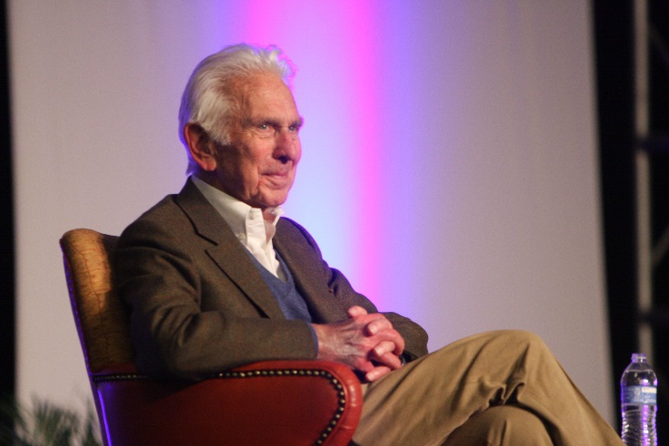
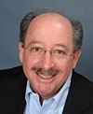
“We believe that great leaders possess four essential skills . . . First is the ability to engage others in shared meaning . . . Second is a distinctive and compelling voice . . . Third is a sense of integrity (including a strong set of values). . . and four is what we call ‘adaptive capacity.’ This is, in essence, applied creativity—an almost magical ability to transcend adversity, with all its attendant stresses, to emerge stronger than before. It’s composes of two primary qualities: the ability to grasp context, and hardiness.”
Warren G. Bennis and Robert J. Thomas, "Crucibles of Leadership," Harvard Business Review 80, no. 9 (2002): 45.

Slide 68
Yes, leaders tend to have these traits
We can even aspire to them.
But what orients them?

Slide 69
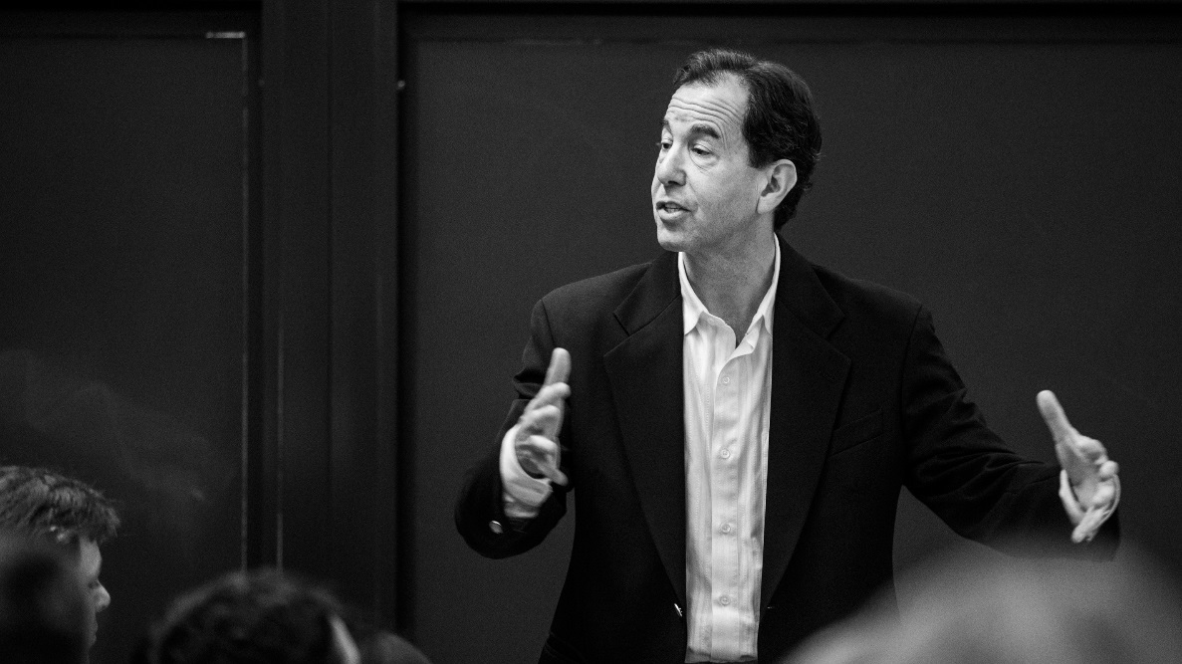
“This ‘survival guide’ has two main parts: . . . advice for (1) ‘the hostile environment’ the leader faces and for (2) the ‘dangers within’ the leader themselves.”
Ronald A. Heifetz and Marty Linsky, "A Survival Guide for Leaders," Harvard Business Review 80, no. 6 (2002): 66, 71.

Slide 70
We are getting closer now to a more adequate understanding.

Slide 71
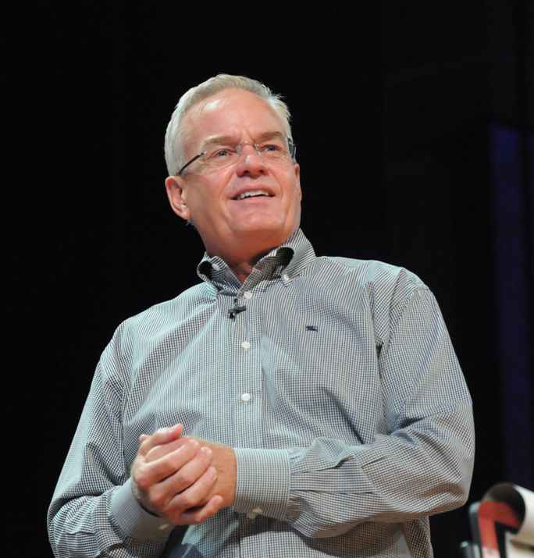
The “three Cs” of team member selection
“My selection process is based on ‘three Cs’: first character, then competence, and finally chemistry with me and the rest of the team.”
Bill Hybels, Courageous Leadership (Grand Rapids, Mich.: Zondervan, 2002), 81.

Slide 72
Characteristics or “traits” worth pursuing: 1 Timothy 3
Here is a trustworthy saying: Whoever aspires to be an overseer desires a noble task. ² Now the overseer is to be above reproach, faithful to his wife, temperate, self-controlled, respectable, hospitable, able to teach, ³ not given to drunkenness, not violent but gentle, not quarrelsome, not a lover of money. ⁴ He must manage his own family well and see that his children obey him, and he must do so in a manner worthy of full^{[a]} respect. ⁵ (If anyone does not know how to manage his own family, how can he take care of God’s church?) ⁶ He must not be a recent convert, or he may become conceited and fall under the same judgment as the devil. ⁷ He must also have a good reputation with outsiders, so that he will not fall into disgrace and into the devil’s trap.
⁸ In the same way, deacons^{[b]} are to be worthy of respect, sincere, not indulging in much wine, and not pursuing dishonest gain. ⁹ They must keep hold of the deep truths of the faith with a clear conscience. ¹⁰ They must first be tested; and then if there is nothing against them, let them serve as deacons.
¹¹ In the same way, the women^{[c]} are to be worthy of respect, not malicious talkers but temperate and trustworthy in everything.
¹² A deacon must be faithful to his wife and must manage his children and his household well.¹³ Those who have served well gain an excellent standing and great assurance in their faith in Christ Jesus.

Slide 73
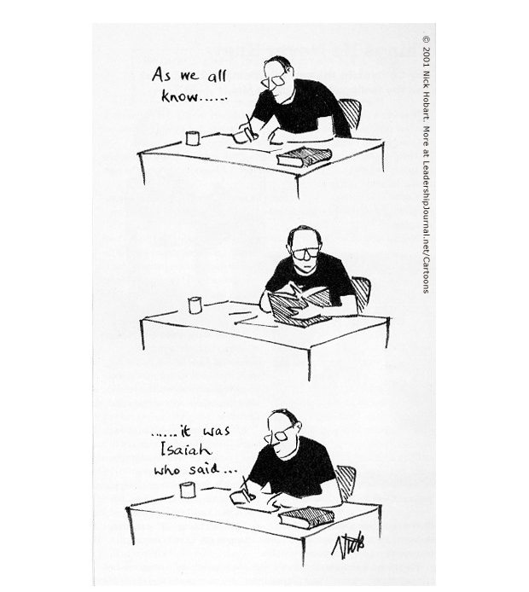
http://www.christianitytoday.com/le/2002/winter/knowing-word.html

Slide 74
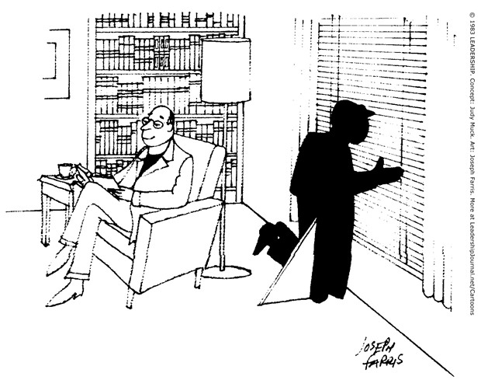
http://www.christianitytoday.com/le/2004/april-online-only/pray-without-ceasing.html

Slide 75
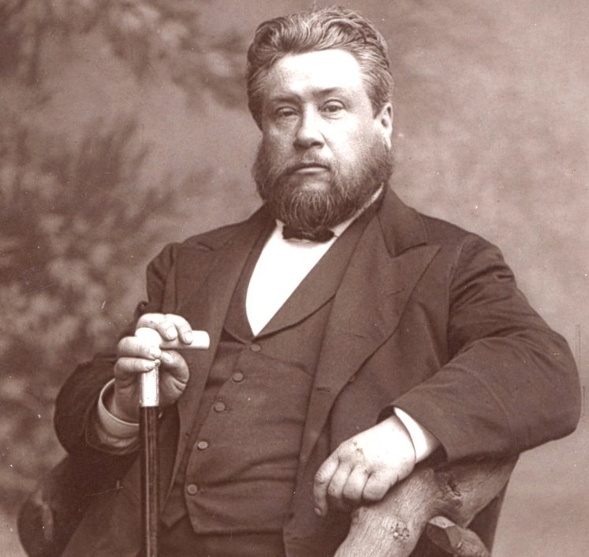
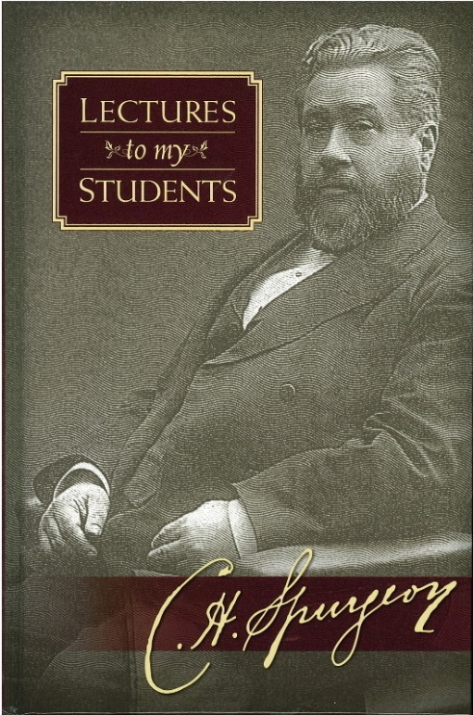
Character
“We shall be likely to accomplish most when we are in the best spiritual condition.”
C. H. Spurgeon, Lectures to My Students: Complete & Unabridged (Grand Rapids, Mich.: Zondervan Pub. House, 1954).

Slide 76
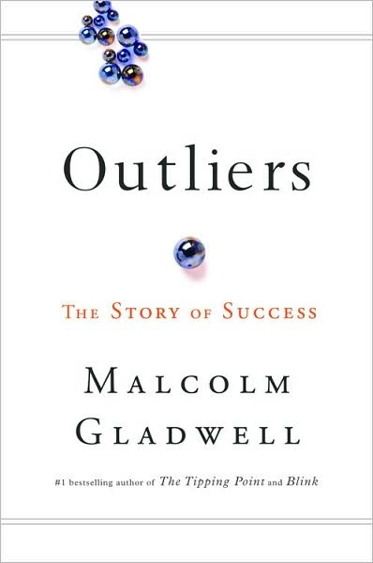
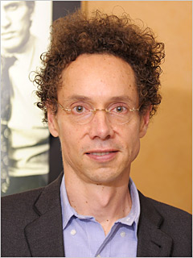
People become what they practice to be.
“Researchers have settled on what they believe is the magic number for true expertise: ten thousand hours.”
Malcolm Gladwell, Outliers: The Story of Success (New York: Little, Brown and Co., 2008), 40.

Slide 77
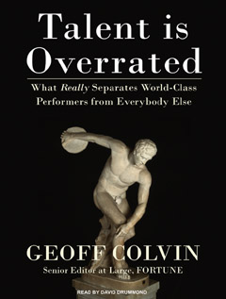
Little things matter
The power of habits and practice

Slide 78
So, it is all hard work and practice makes perfect, huh? Not exactly.
“All of the outliers we’ve looked at so far were the beneficiaries of some kind of unusual opportunity. Lucky breaks don’t seem like the exception with software billionaires and rock bands and star athletes. They seem like the rule.”
Malcolm Gladwell, Outliers: The Story of Success (New York: Little, Brown and Co., 2008), 56.

Slide 79
But who again is the true source of our power and privilege? Abigail?
“26 And now, my lord, as surely as the Lord your God lives and as you live, since the Lord has kept you from bloodshed and from avenging yourself with your own hands . . . 28 The Lord your God will certainly make a lasting dynasty for my lord . . . 29 the life of my lord will be bound securely in the bundle of the living by the Lord your God . . . 30 When the Lord has fulfilled for my lord every good thing he promised concerning him and has appointed him ruler . . . 31 And when the Lord your God has brought my lord success . . . ” (1 Sam 25 NIV)

Slide 80
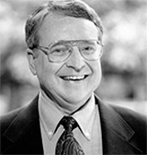
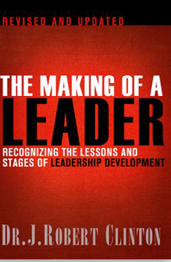
Robert Clinton on the Phases of a Leader’s Life
Sovereign foundations: God works through family, environment, and historical events.
Inner-life growth: the leader seeks to know God in a more personal, intimate way. The leader faces tests of obedience and integrity.
Ministry maturing: the leader is experimenting with spiritual gifts. They may get training to become more effective and will face tests of relationships and discernment.
Life maturing: The leader has identified and is using their spiritual gifts in a ministry that is satisfying. Their character will become apparent in situations of conflict, isolation, and authority.
Convergence: Some leaders get the opportunity to be in a role that matches their gift-mix.
Afterglow: For a very few, the fruit of a lifetime of ministry and growth culminates in an era of recognition and indirect influence at broad levels.
J. Robert Clinton, The Making of a Leader: Recognizing the Lessons and Stages of Leadership Development, Rev ed. (Colorado Springs, CO: NavPress, 2012), 37-40.

Slide 81
1 Cor 4:7
For who makes you different from anyone else? What do you have that you did not receive? And if you did receive it, why do you boast as though you did not?

Slide 82
Relationships
Unleashing and guiding personality in leadership

Slide 83
Bill, Tom, Malcolm, and Paul (1 of 3)
Bill, Tom, Malcolm, and Paul are at Starbucks after going to their church’s worship service.
Tom: There are so many musicians who attend this church. I am wondering why it is always the same person up there leading music.
Paul: Yeah. Ideally there is a sense in which we all were contributing something when we gather.
Malcolm: I wonder whether the person leading has enough time to prepare quality and diverse music. There are times in which you wonder whether the worship team has put a lot of thought into the songs they select. And the coordination with the sound team is off sometimes so you can hardly hear the person singing the melody.
Bill: This seems like a question the senior pastor should be addressing. What is the system for including new people? How do we instill a sense that we are not just consumers but all who attend are participants? And are those who plan worship putting in the research and rehearsal time to actually produce better results? But the problem is the senior pastor is far too nice. What we need is someone with the gift of leadership—someone who will get in there and knock some heads!

Slide 84
Bill, Tom, Malcolm, and Paul (2 of 3)
Paul: I agree there should be someone who gives attention to the worship service but I wonder whether they have to be this take charge leader you seem to be describing, Bill. I think of the different kinds of parenting styles. Some parents are pretty gentle and yet their kids really respond well.
Tom: Yeah, I mean if we were talking about “StrengthsFinder,” I think Bill you would be talking about the people who are strong in “Command”—taking charge. But the StrengthsFinder trait of “command” only helps with influencing—a group still needs people who will help with execution, relationships, and strategic thinking.
Malcolm: What I worry about is that when we talk about “strengths” and “talent,” we can actually discourage people from developing who they are because we have labeled them. The worship leader and the senior pastor might be able to attend to these issues if the issues were brought to their attention. I worry that this idea of “strengths” and “talents” leads us to discard people because we need someone with the right “gifts.”
Bill: The leopard does not change its spots. As Jim Collins says, “Get the right people on the bus.” People are not going to become leaders if they are not leaders. Period.

Slide 85
Bill, Tom, Malcolm, and Paul (3 of 3)
Tom: I suppose I would take a middle position here between Malcolm and Bill. Talent plus hard work leads to someone having a strength. So I do think it would be worth working with the worship leader and pastor but there probably is a limit to what they can learn if they do not have much innate talent.
Paul: What seems important though is for everyone in the church to be developing and exercising their gifts. And for us all to be making every effort to encourage and appreciate one another’s gifts—even when they might be different from our own.

Slide 86
People become what they practice to be.
“Researchers have settled on what they believe is the magic number for true expertise: ten thousand hours.”
Malcolm Gladwell, Outliers: The Story of Success (New York: Little, Brown and Co., 2008), 40.

Slide 87
Little things matter
The power of habits and practice

Slide 88
So, it is all hard work and practice makes perfect, huh? Not exactly.
“All of the outliers we’ve looked at so far were the beneficiaries of some kind of unusual opportunity. Lucky breaks don’t seem like the exception with software billionaires and rock bands and star athletes. They seem like the rule.”
Malcolm Gladwell, Outliers: The Story of Success (New York: Little, Brown and Co., 2008), 56.

Slide 89
Carl Jung and Personality Types
Extraversion versus introversion
Sensing versus intuiting
Thinking versus feeling
Judging versus perceiving
Peter G. Northouse, Leadership: Theory and Practice, 6th ed. (Thousand Oaks, CA: SAGE, 2013), 330-331.

Slide 90
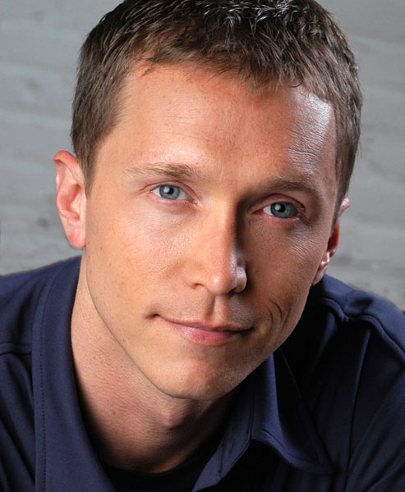
Tom Rath
http://www.strengthstest.com/strengthsfinderthemes/leadership-themes.html

Slide 91
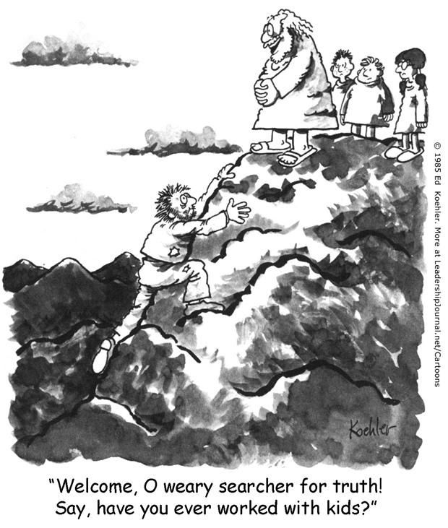
http://www.christianitytoday.com/le/2004/april-online-only/pushing-people-into-ministry.html

Slide 92
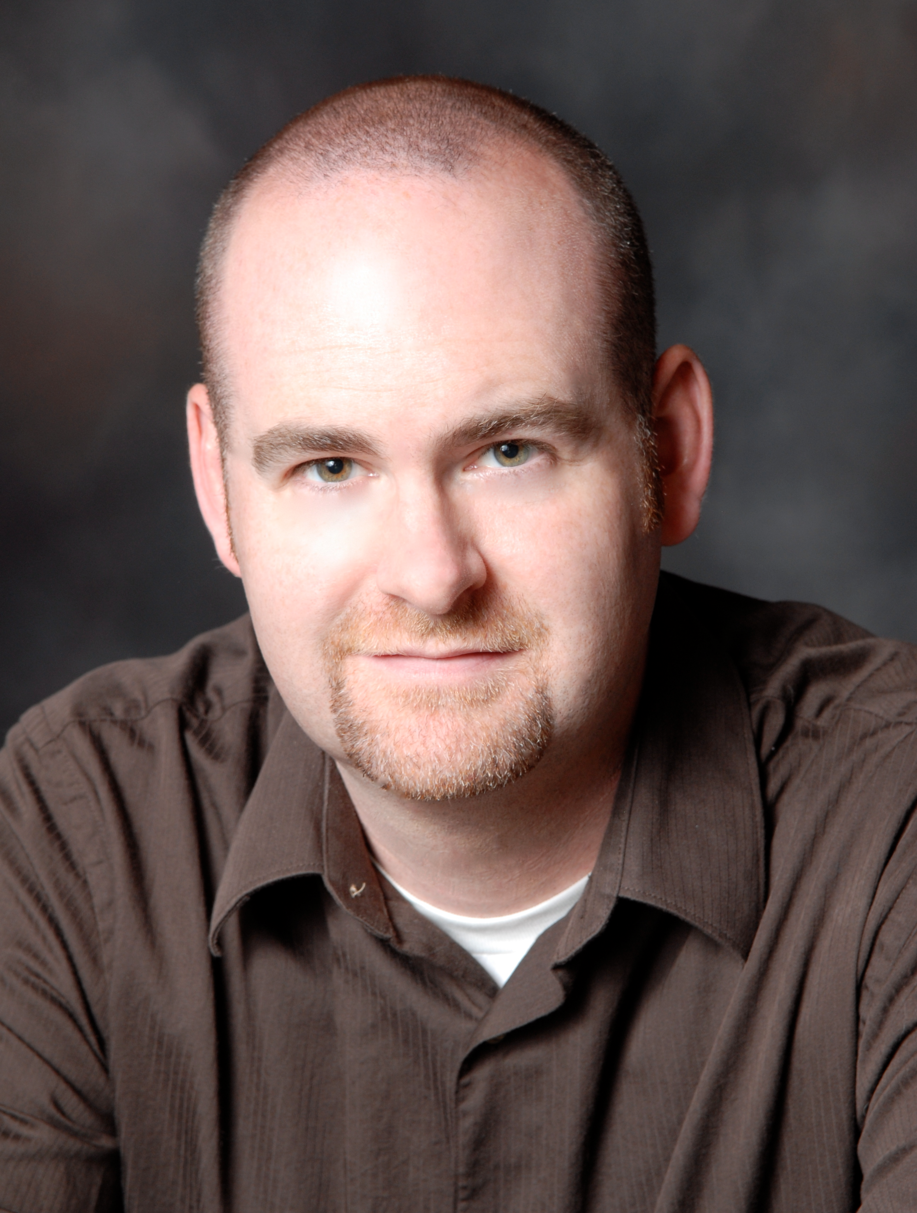
What does it mean to be gifted for leadership?
Adam S. McHugh, Introverts in the Church: Finding Our Place in an Extroverted Culture (Downers Grove, Ill.: IVP Books, 2009).

Slide 93
Born leaders. Gifted to lead.
The argument for innate leadership characteristics

Slide 94
Receive and utilize the gifts you have been given.
³ For by the grace given me I say to every one of you: Do not think of yourself more highly than you ought, but rather think of yourself with sober judgment, in accordance with the faith God has distributed to each of you. ⁴ For just as each of us has one body with many members, and these members do not all have the same function, ⁵ so in Christ we, though many, form one body, and each member belongs to all the others. ⁶ We have different gifts, according to the grace given to each of us. If your gift is prophesying, then prophesy in accordance with your faith; ⁷ if it is serving, then serve; if it is teaching, then teach; ⁸ if it is to encourage, then give encouragement; if it is giving, then give generously; if it is to lead, do it diligently; if it is to show mercy, do it cheerfully.
Romans 12:3-8

Slide 95
All of the gifts in Romans 12:6-8 could technically be used for "leadership" -- helping the group achieve a common goal. The so called "gift of leadership" (Rom 12:8) is more accurately described as a gift of oversight or administration or management. It is related to "managing" one's family correctly and "managing" the affairs of the church. And the person is to do this "conscientiously." This "leading diligently" is rather "managing conscientiously" and is not some Type A, pioneering, vision-casting, charismatic (Max Weber's definition) figure.

Slide 96
Leaders have a gift.
“The local church is the hope of the world and its future rests primarily in the hands of its leaders. For the first time, I realized that from a human perspective the outcome of the redemptive drama being played out on planet Earth will be determined by how well church leaders lead . . . The question is this: Will the men and women who have been entrusted with leadership gifts take their gifts seriously, develop them fully, and deploy them courageously, so that the willing and gifted believers in their churches can work together to make a difference in the world?”
Bill Hybels, Courageous Leadership (Grand Rapids, Mich.: Zondervan, 2002), 27.

Slide 97
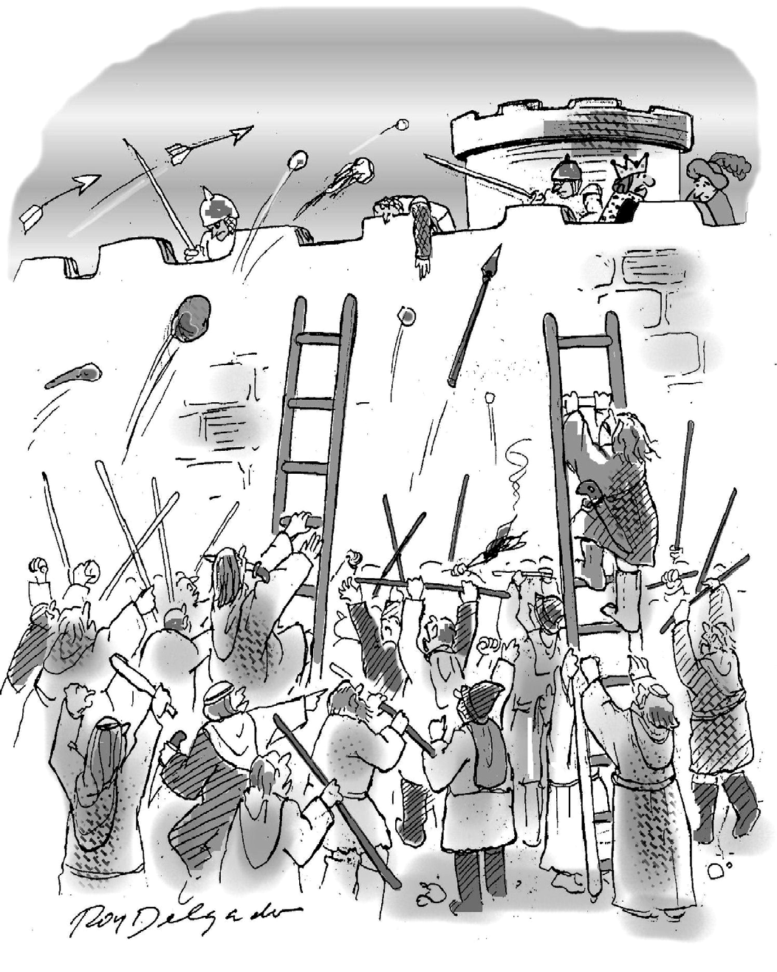
Would a management class really help this?
“I regret not taking management classes.”
Harvard Business Review January–February 2014 p. 84

Slide 98
But management classes are futile, say some.
“Teaching leaders will result in better leaders. Teaching leadership to pastors, preachers, and teachers results in pastors, preachers, and teachers who’ve taken a leadership course. A leadership course may make them better, but it won’t make them leaders . . . Leadership is a gift. If you have it, Paul would tell you to lead diligently. If you don’t, discover the gifts God has blessed you with and lean into them with all your heart.”
Andy Stanley, Deep & Wide: Creating Churches Unchurched People Love to Attend (Grand Rapids, Mich.: Zondervan, 2012), 295, 300.

Slide 99
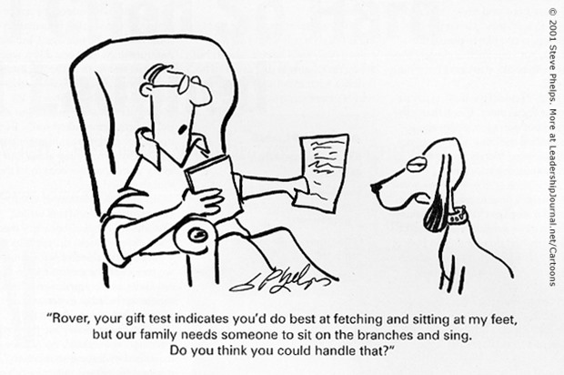
The idea is: Don’t fight nature
http://www.christianitytoday.com/le/2001/spring/rovers-spiritual-gifts.html

Slide 100
Developing leaders
The argument for equipping, releasing, encouraging, and supporting potential leaders

Slide 101
Develop what you don’t have – 1 Cor 12
27 Now you are the body of Christ, and each one of you is a part of it. 28 And God has placed in the church first of all apostles, second prophets, third teachers, then miracles, then gifts of healing, of helping, of guidance, and of different kinds of tongues. 29 Are all apostles? Are all prophets? Are all teachers? Do all work miracles? 30 Do all have gifts of healing? Do all speak in tongues? Do all interpret? 31 Now eagerly desire the greater gifts.

Slide 102
Develop the gift you have been given
5 I am reminded of your sincere faith, which first lived in your grandmother Lois and in your mother Eunice and, I am persuaded, now lives in you also.6 For this reason I remind you to fan into flame the gift of God, which is in you through the laying on of my hands. 7 For the Spirit God gave us does not make us timid, but gives us power, love and self-discipline.
2 Tim 1:5-7

Slide 103
Neither determinism nor fairness
Take what you have been given and develop it further

Slide 104
Take what you have been given and utilize them
22 “The man with two bags of gold also came. ‘Master,’ he said, ‘you entrusted me with two bags of gold; see, I have gained two more.’ 23 “His master replied, ‘Well done, good and faithful servant! You have been faithful with a few things; I will put you in charge of many things. Come and share your master’s happiness!’
Matt 25:22-23

Slide 105
Responses to Hybels and Stanley
Which group are we talking about? We are not leaders in every group we are part of.
Hybels and Stanley are both strong in evangelism and leadership. That is no accident. Evangelism or mission or “change” takes a leader—in that it is about steering a group beyond the status quo toward a common goal. I wonder if they are more “apostles” (sent evangelists) (1 Cor 12:28-29) than leadership (Rom 12:8).

Slide 106
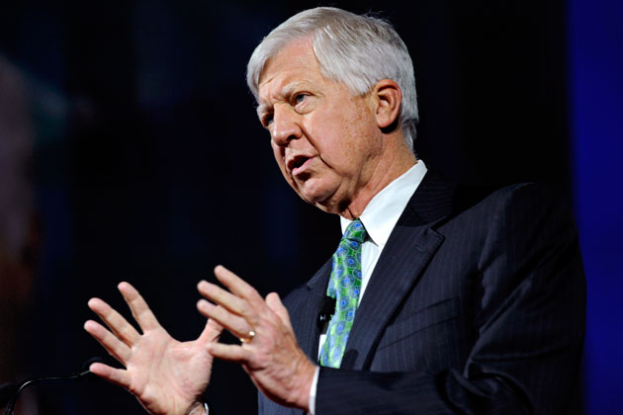
Bill George’s authentic leadership approach
Leaders should become more:
Purposeful
Value centered
Relational
Self-disciplined
Compassionate
Peter G. Northouse, Leadership: Theory and Practice, 7th ed. (Thousand Oaks, CA: SAGE, 2016), ch. 9.

Slide 107
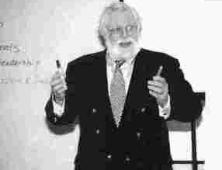
Robert Terry’s authentic leadership approach
What is really, really going on?
Assess employees’ organizational concerns in six categories:
Mission: Goals, objectives, and desires
Power: Energy, motivation, morale, and control
Structure: Systems, policies, and procedures
Resources: People, capital, information, equipment, and time
Existence: History and identity
Meaning: Guiding values, principles, and ethics
Peter G. Northouse, Leadership: Theory and Practice, 7th ed. (Thousand Oaks, CA: SAGE, 2016), ch. 9.

Slide 108
Carl Jung and Personality Types
Extraversion versus introversion
Sensing versus intuiting
Thinking versus feeling
Judging versus perceiving
Peter G. Northouse, Leadership: Theory and Practice, 7th ed. (Thousand Oaks, CA: SAGE, 2016), ch. 12.

Slide 109
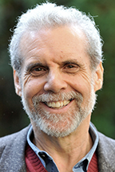
Daniel Goleman: Great leaders have high Emotional Intelligence
Self-awareness
Self-regulation
Motivation
Empathy
Social skill
Daniel Goleman, "What Makes a Leader?," Harvard Business Review 76, no. 6 (1998): 95.

Slide 110
Pete Scazzero on the leader’s emotional health
“We always seems to have too much to do in too little time. While the church was an exciting place to be, it was not a joy to be in leadership . . . There was a high turnover of staff and leaders.”
“My hell was that inside I was deeply wounded and angry. These feelings gave way to hate.”
“I struggled to be honest with how I presented the situation to others. I had a terrible habit of embellishing or editing the truth lest people get upset.”
“Examining my heart revealed a mixed set of drives. Part of my passion was for God’s glory. Other parts were driven by a complex set of motives that I did not have the tools or time to sort out.”
Peter Scazzero and Warren Bird, The Emotionally Healthy Church: A Strategy for Discipleship That Actually Changes Lives, Expanded ed. (Grand Rapids, Mich.: Zondervan, 2010), 26, 28, 29, 32.

Slide 111
Gifts

Slide 112
Finding career direction

Slide 113
Conclusion on gifts

Slide 114
Next time

Slide 115
The approach of a great leader: Innovation, Discipline, and Results.
Nov 15. Title: The approach of a great leader: Innovation, Discipline, and Results. Text: 1 Peter 3:8-18. Topics: Savvy in a wild world. Perseverance. Neither optimism nor pessimism. Navigating through the gauntlet of organizational chaos.

