Slide 1
“Theological Issues of the Day” with David Clark, Andy Rowell and Mark Strauss.
Friday, October 10, 2014
1:45 pm

Slide 2
The Confident and Contextual church amidst confusion
Andy Rowell
Slides at www.andyrowell.net

Slide 3
Latest national statistics on GLBT and churches
"In just six years, the number of congregations whose leaders said that gays and lesbians could be full-fledged members increased from 37.4 percent to 48 percent. The number of congregations whose leaders said that no volunteer leadership positions were closed to gays and lesbians increased from 17.7 percent to 26.4 percent . . . Although more white conservative Protestants churches expressed acceptance of gay and lesbian members in 2012 than in 2006 (increasing from 16 percent to 24 percent), there was no increase in acceptance of gay or lesbian leaders (only 4 percent in 2012) within white conservative Protestant churches."
Mark Chaves and Shawna L. Anderson, "Changing American Congregations: Findings from the Third Wave of the National Congregations Study," Journal for the Scientific Study of Religion, (December 2014).
http://www.soc.duke.edu/natcong/Docs/Changing_American_Congs.pdf

Slide 4
Religious trends
According to Todd M. Johnson and his team of researchers in international religious demography, 1/3 of the world’s population are identified as Christians. It was 33.2% in 1970 and it is projected to be 33.3% in 2020.
Todd M. Johnson, Christianity in Its Global Context, 1970–2020: Society, Religion, and Mission (South Hamilton, MA: Center for the Study of Global Christianity at Gordon-Conwell Theological Seminary, 2013), 9-10. Online: http://wwwgordonconwell.com/netcommunity/CSGCResources/ChristianityinitsGlobalContext.pdf Cf. Gina A. Bellofatto and Todd M. Johnson, "Key Findings of Christianity in Its Global Context, 1970-2020," International Bulletin of Missionary Research 37, no. 3 (2013).

Slide 5
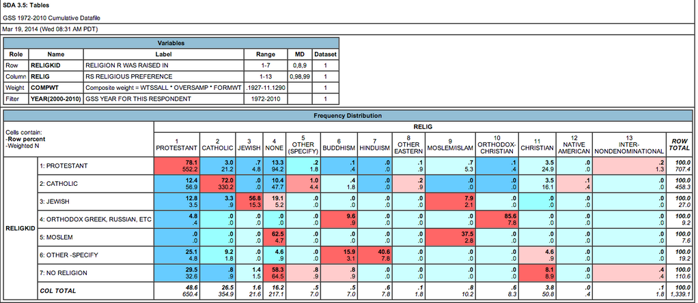
Religious Switching https://twitter.com/GabrielRossman/status/446308609232613377 29.5% who are born with no religion become Protestants 78.1% of Protestants remain Protestant
Slide here

Slide 6
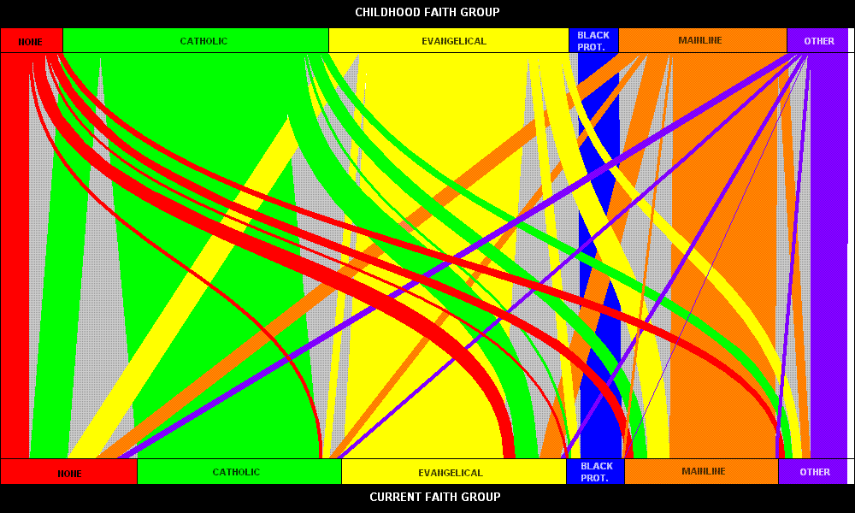
While Christians focus on losses out of Christianity into no religion, the reverse happens to, perhaps to a greater degree. It appears that a greater proportion of non-religious people become Evangelical than the reverse. In general, non-religion is a leaky bucket, losing a lot of its people to Christianity. Also, there isn't much switching into Catholicism, but there sure is a lot out. http://brewright.blogspot.com/2009/05/graph-of-religious-switching.html http://www.pewforum.org/2009/04/27/faith-in-flux/
Chart here

Slide 7
1 Tim. 1:4, 7
"Such things promote controversial speculations rather than advancing God's work … they do not know what they are talking about or what they so confidently affirm."

Slide 8
Willow Creek’s Reveal debacle – as described by sociologist Bradley Wright
In the foreword to the book, Bill Hybels, senior pastor of Willow Creek, describes the findings as almost "unbearably painful." The findings of REVEAL, he writes, "revolutionized the way I look at the role of the local church." Coming from as successful a pastor as Bill Hybels, this is a powerful statement.
Is such a strong reaction warranted? I would say probably not, and here's why...
The type of survey used by REVEAL has its uses, but it's not well suited for evaluating the effectiveness of a complex institution like a church. It's not that REVEAL's findings are wrong, rather they are highly inconclusive. In fact, if I had to make a judgment, I would interpret the findings as generally supportive of what Willow Creek is already doing.
Bradley Wright, “REVEAL Revisited: One sociologist says Willow Creek's research may not be as revealing as we think.” Leadership Journal’s Out of Ur blog (Jan 14, 2008). Online: http://www.christianitytoday.com/parse/2008/january/reveal-revisited.html

Slide 9
The American Church might not be in crisis
David T. Olson, The American Church in Crisis (Grand Rapids: Zondervan, 2008).
What Olson seems to be saying is that: "Attendance is down in the churches for which I have records." This says something but one needs to be careful about generalizing to the entire American church.http://www.andyrowell.net/andy_rowell/2008/11/weekly-usa-church-attendance-the-sociologists-weigh-in.html
D. Michael Lindsay, assistant professor of sociology at Rice University and now president of Gordon College, notes in response to Olson's research: "Counting heads to estimate weekly worship service attendance is far less reliable than estimates based on survey responses . . . For researchers to generalize head counts to the entire adult population, they must be conducted as an exhaustive consensus or a representative sample.”
D. Michael Lindsay, "Gallup's Research Remains More Reliable Than Counting Heads," Rev. Magazine (Mar/Apr 2008): 59.

Slide 10
The conclusions of UnChristian are exaggerated
Bradley Wright, “My take on these data is that they certainly should be viewed with caution, and they may even demonstrate a positive view of Christians. If a student turned this in for a class assignment, I would tell him that he has an interesting research question, but he should redo his analysis and presentation.”
Bradley R. Wright, Christians Are Hate-Filled Hypocrites . . . And Other Lies You've Been Told : A Sociologist Shatters Myths from the Secular and Christian Media (Minneapolis, Minn.: Bethany House, 2010), 17.
See also his criticism of the UnChristian by David Kinnaman in chapter 8.
See my review of Wright’s book: http://www.booksandculture.com/articles/webexclusives/2010/september/hatefilledhypocrites.html

Slide 11
Fourteen Theories Of Church Growth From Seven Research Teams
Here is a summary of the 14 factors which I document fully below: (1) witnessing, (2) strictness, (3) high fertility rates, (4) caring for children and youth, (5) high involvement, (6) welcoming new people, (7) leadership, (8) prayer, (9) being a church of 1000+ attendees or under 50 attendees, (10) being located in rural counties, (11) being in rapidly growing zip codes, (12) being in a tradition that is altering worship practices slightly but not too much, (13) churches that offer “intimacy and choice” and (14) attractive worship style, senior pastor, and church reputation.
http://www.andyrowell.net/andy_rowell/2009/06/fourteen-theories-of-church-growth-from-seven-research-teams.html

Slide 12
For Christians, statistics are descriptive, not prescriptive.
While helpful in the decision-making process, statistics do not tell Christians what they should do. The church deliberating under the Scriptures tells us what to do. A statistic which seems to indicate that a Christian response is inadvisable does not mean a Christian should jettison it. As Karl Barth defiantly said in 1933 after Hitler's party had been elected into power in Germany, "The decisive things which I seek to bring to these problems today is to carry on theology, and only theology, now as previously, and as if nothing had happened." In other words, in the tumult of seemingly discouraging events, Christians need not be dissuaded from doing what they know to be right.
Karl Barth, Theological Existence to-Day! A Plea for Theological Freedom (London: Hodder and Stoughton, 1933), 9.

Slide 13
Numbers 13-14
In Numbers 13-14, ten spies reported that the people in the land were so strong that the people of Israel seemed like grasshoppers. Joshua and Caleb saw the same data but insisted the interpretation by the spies was flawed. The minority faith-full report was vindicated.

Slide 14
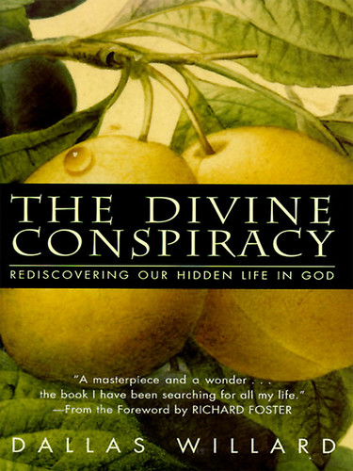
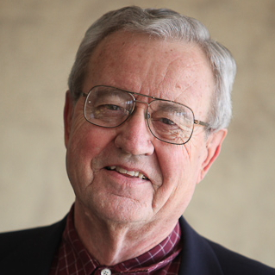
Dallas Willard
“Most . . . [have] no clue whether we are flying upside down or right-side up.”
Dallas Willard, The Divine Conspiracy: Rediscovering Our Hidden Life in God (San Francisco: HarperSanFrancisco, 1998), 2.

Slide 15
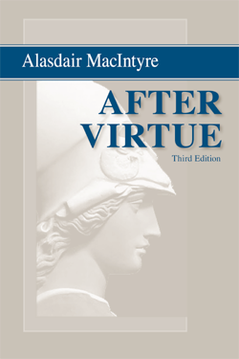
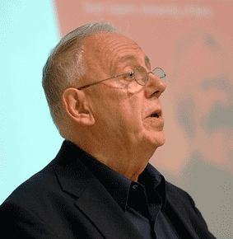
A disquieting suggestion
“There seems to be no rational way of securing moral agreement in our culture.”
Alasdair MacIntyre, After Virtue, 3rd ed. (Notre Dame: University of Notre Dame Press, 2007), 1, 6.

Slide 16
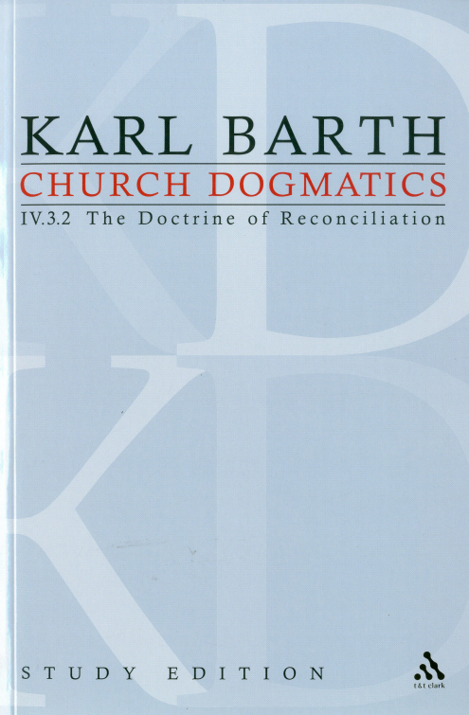
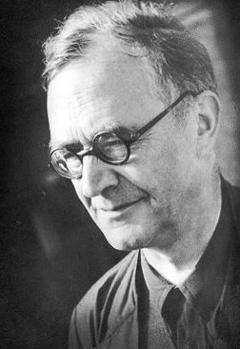
Humanity is confused
The expression hominum confusio [human confusion] is theologically appropriate because it says neither too little nor too much.
Karl Barth, Church Dogmatics, 4 vols. in 13 parts vols. (New York: T&T Clark, 1956-1969, 1975, 2009), IV/3.2, 695.

Slide 17
COPENHAGEN CONSENSUS 2004
Control of HIV/AIDS
Providing micro nutrients
Trade liberalisation
Control of malaria
Development of new agricultural technologies
Small-Scale water technology for livelihoods
Community-managed water supply and sanitation
Research on water productivity in food production
Lowering the cost of starting a new business
Lowering barriers to migration for skilled workers
Improving infant and child nutrition
Reducing the prevalence of low birth weight
Scaled-up basic health services
Guest worker programmes for the unskilled
Optimal carbon tax
See also: http://www.copenhagenconsensus.com/projects/copenhagen-consensus-2008/outcome

Slide 18
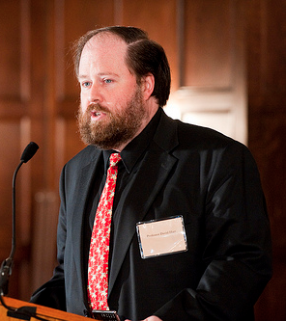
BUT IT IS VESTIGES OF THE CHRISTIAN FAITH WHICH INTELLECTUALLY FUNDS THIS ACTIVISM.
“Law enforcement,” “international development,” “nation building,” “human rights,” “job creation” are all relatively good things to be involved in. In fact, the Christian faith has arguably inspired and its residual effects on the culture dignify all of these things.
Pagan societies prior to Christianity certainly did not value these things though:
“something of the old classicist nostalgia lingers on . . . there have been historians and classicists who have preferred to call attention to the pervasiveness of the ‘tragic’ element in the culture of antiquity: the darkness haunting much of its mythology, the capriciousness and brutality of the pagan divine, the morbidity of certain philosophical schools, the misery and despair with which death was contemplated, the fear of occult forces within nature, the religious reliance upon sacrifices of appeasement and impetration, the violence of many sacral practices, and above all a nearly universal acquiescence to the law of fate.”
David Bentley Hart, Atheist Delusions: The Christian Revolution and Its Fashionable Enemies (New Haven: Yale University Press, 2009), 130, 131-132.

Slide 19
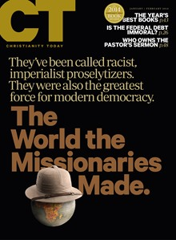
The positive power of missionaries
“Why did some countries become democratic, while others went the route of theocracy or dictatorship?" asks Daniel Philpott, who teaches political science and peace studies at the University of Notre Dame. "For [Woodberry] to show through devastatingly thorough analysis that conversionary Protestants are crucial to what makes the country democratic today [is] remarkable in many ways. Not only is it another factor—it turns out to be the most important factor. It can't be anything but startling for scholars of democracy.”
Andrea Palpant Dilley, "The World the Missionaries Made (Cover Story): The Surprising Discovery About Those Colonialist, Proselytizing Missionaries. They Didn’t Set out to Change History. But One Modern Scholar’s Research Shows They Did Just That.," Christianity Today 58, no. 1 (2014): 40.

Slide 20
Through the church – Eph 3:10
“Before the creation of the world,” (Eph 1:4), God’s plan was to use a people to be point to him. “His intent was that now, through the church, the manifold wisdom of God should be made known!” (Eph 3:10).

Slide 21
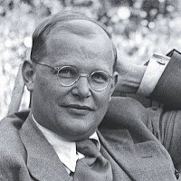
There should be potency about us.
“All this they are to do in the midst of this world and without reservation, in order to bear witness to the fact that the world is lost and the new creation has come about in the church-community . . . Christians are to remain in the world in order to engage the world in a frontal assault.”
Dietrich Bonhoeffer, Discipleship, trans., Barbara G. Green and Reinhard Krauss, Dietrich Bonhoeffer Works, vol. 4 (Minneapolis: Fortress, 2001), 244.
Notes:
This is chapter eleven entitled “The Visible Church-Community” from Bonhoeffer’s Discipleship—written in German in 1935-1936 and published in 1937 at the height of Hitler’s power and translated into English here. Bonhoeffer was executed by order of Hitler in 1945. You are welcome to read the chapter in your own version of Cost of Discipleship: it may be chapter 30 and entitled “The Visible Community.” Bonhoeffer is concious of evil leadership and the importance of Christians to boldly follow Jesus—which involves leadership. When Bonhoeffer says “community” or “church-community” he is talking about a local church or group of Christians (Gemeinde).

Slide 22
This is the rationale for:
Theological education
Denominational resources

Slide 23
What might it mean to eat with outsiders
But the Pharisees and the teachers of the law muttered, “This man welcomes sinners and eats with them.” Luke 15:2
If an unbeliever invites you to a meal and you want to go, eat whatever is put before you without raising questions of conscience. 1 Cor 14:27
Just then his disciples returned and were surprised to find him talking with a woman. John 4:27

Slide 24
This is the rationale for:
Congregational polity – experimentation on the local level

Slide 25
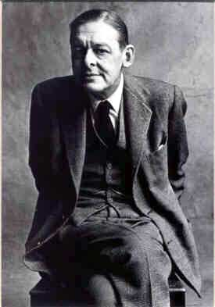
We should communicate without being vulgar or pedantic.
“And every phrase / And sentence that is right . . . The common word exact without vulgarity, / The formal word precise but not pedantic.”
T. S. Eliot, Four Quartets (New York: Harcourt, Brace, & Company 1943),58.

Slide 26
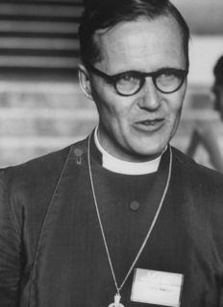
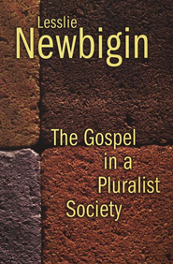
Sign, instrument, and foretaste
“If the gospel is to challenge the public life of our society . . . it will only be by movements that begin with the local congregation in which the reality of the new creation is present, known, and experienced, and from which men and women will go into every sector of public life to claim it for Christ, to unmask the illusions which have remained hidden and to expose all areas of public life to the illumination of the gospel. But this will only happen as and when local congregations renounce an introverted concern for their own life, and recognize that they exist for the sake of those who are not members, as sign, instrument, and foretaste of God’s redeeming grace for the whole life of society.”
Lesslie Newbigin, The Gospel in a Pluralist Society (Grand Rapids, Mich.: Eerdmans, 1989), 232-233.

